Slide 1
Developing Retrieval Algorithms for NH₃ (and CO) from NPP CrIS Measurements
Karen Cady-Pereira¹, Helen Worden²
1. Atmospheric and Environmental Research (AER)
2. NCAR/NESL/ACD
Also: Mark Shephard, Ming Luo, Daven Henze, Juliet Zhu, Kang Sun, Mark Zondlo, Armin Wisthaler, AmyJo Scarino, Chantelle Londsale, Matthew Alvarado, Robert Pinder, John Walker, Jesse Bash

Slide 2
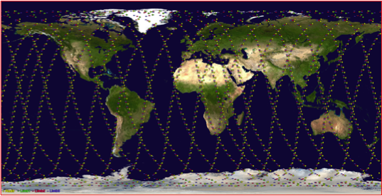
TES and CrIS instruments
 | TES | CrIS
Satellite | AURA | NPP
Launch | July 2004 | October 2011
Resolution | 0.06 cm⁻¹ | 0.625 cm⁻¹
Footprint | 5x8 km rectangle | 14 km diameter circle
Repeat cycle | Once every 16 days | Daily
Equatorial crossing | 1:30 am and 1:30 pm | 1:30 am and 1:30 pm
Noise in NH3 window | 0.09 – 0.12 K | 0.03 – 0.06 K
Two TES observation modes:
Global Surveys: 26 hours long, return to starting point every 16 days
Special Observations: higher sampling density over shorter tracks
0.625 cm⁻¹ resolution is key for accurate CO retrievals

Slide 3
Why CO?
O
C
Important role in atmospheric chemistry & climate
  Sources are incomplete combustion (both fires & fossil fuel) & hydrocarbon oxidation
  Primary sink is oxidation by OH
  Precursor to CO₂ and tropospheric O₃
  Indirect RF of 0.23 W/m² for CO emissions (IPCC AR5)
Ideal tracer for pollution transport
  Lifetime is weeks to months, so CO is transported globally, but not evenly mixed (like longer lived species)
  Easy to measure elevated CO above background levels
Global direct emissions of CO (~half of atmos. CO)
  ~500-600 Tg/yr anthropogenic (relatively stable)
  ~300-600 Tg/yr biomass burning (large interannual variability)

Slide 4
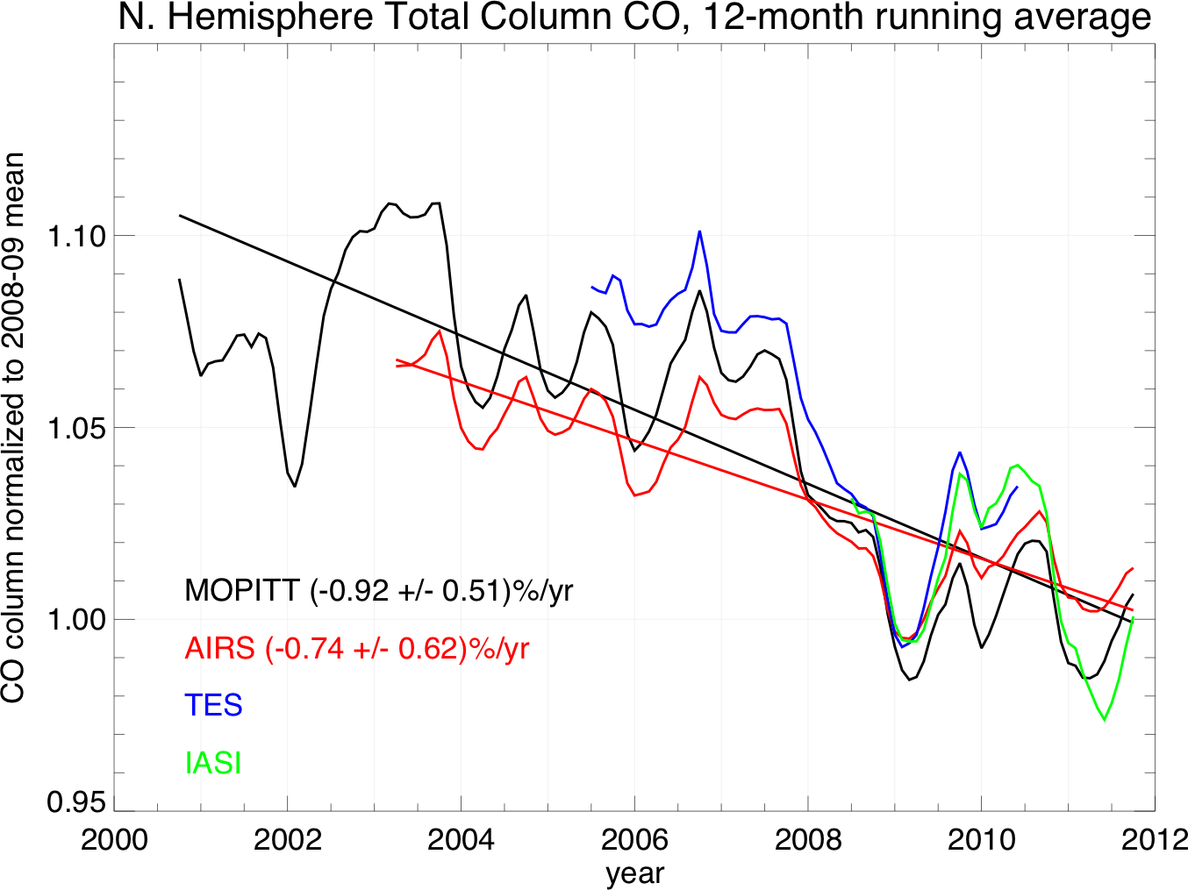
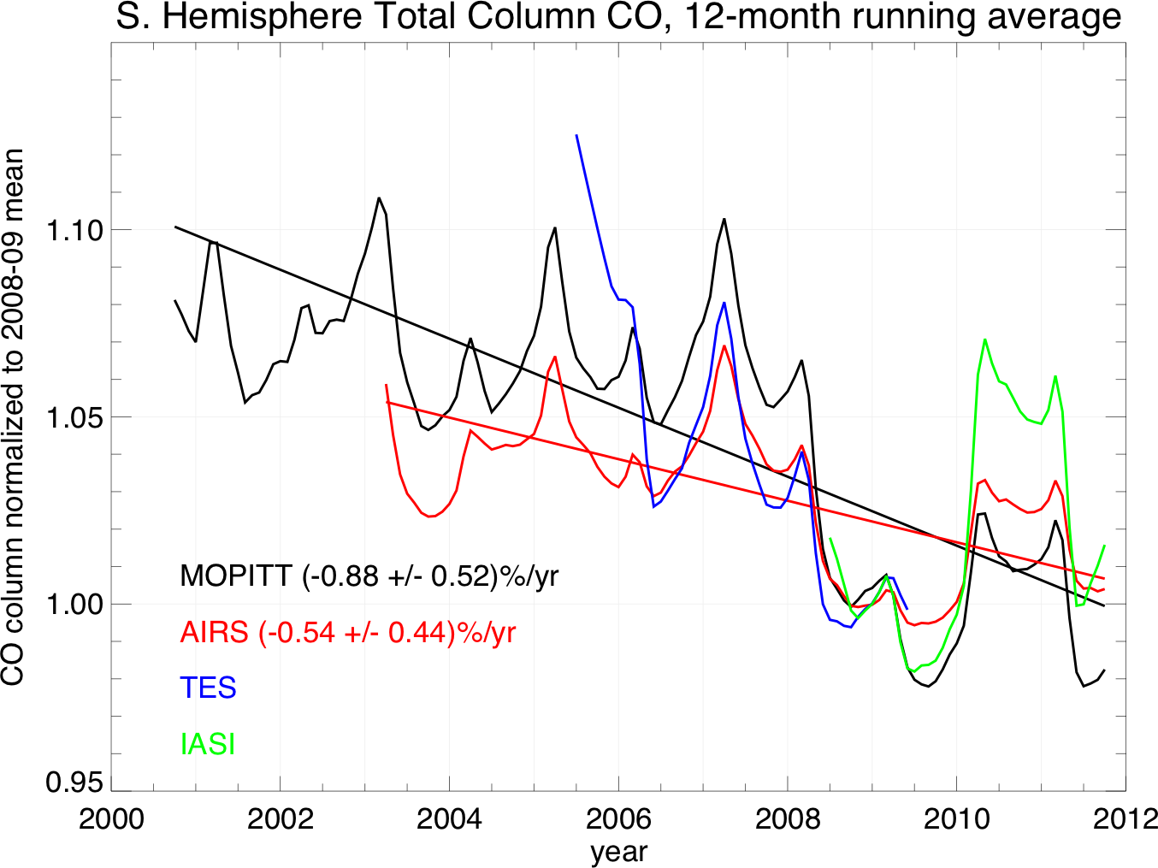
CO has a trend
N. Hemisphere
Consistent with a continuation of 1991-2001 trend for
NH surface CO: -0.8%/year (Novelli et al., JGR, 2003)
S. Hemisphere

Slide 5
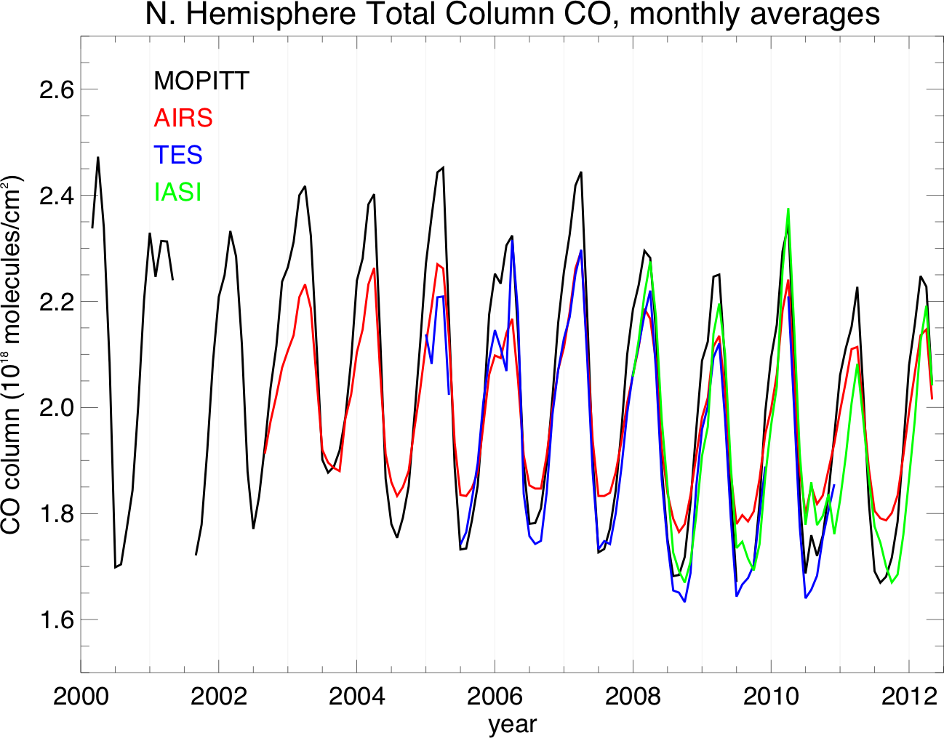
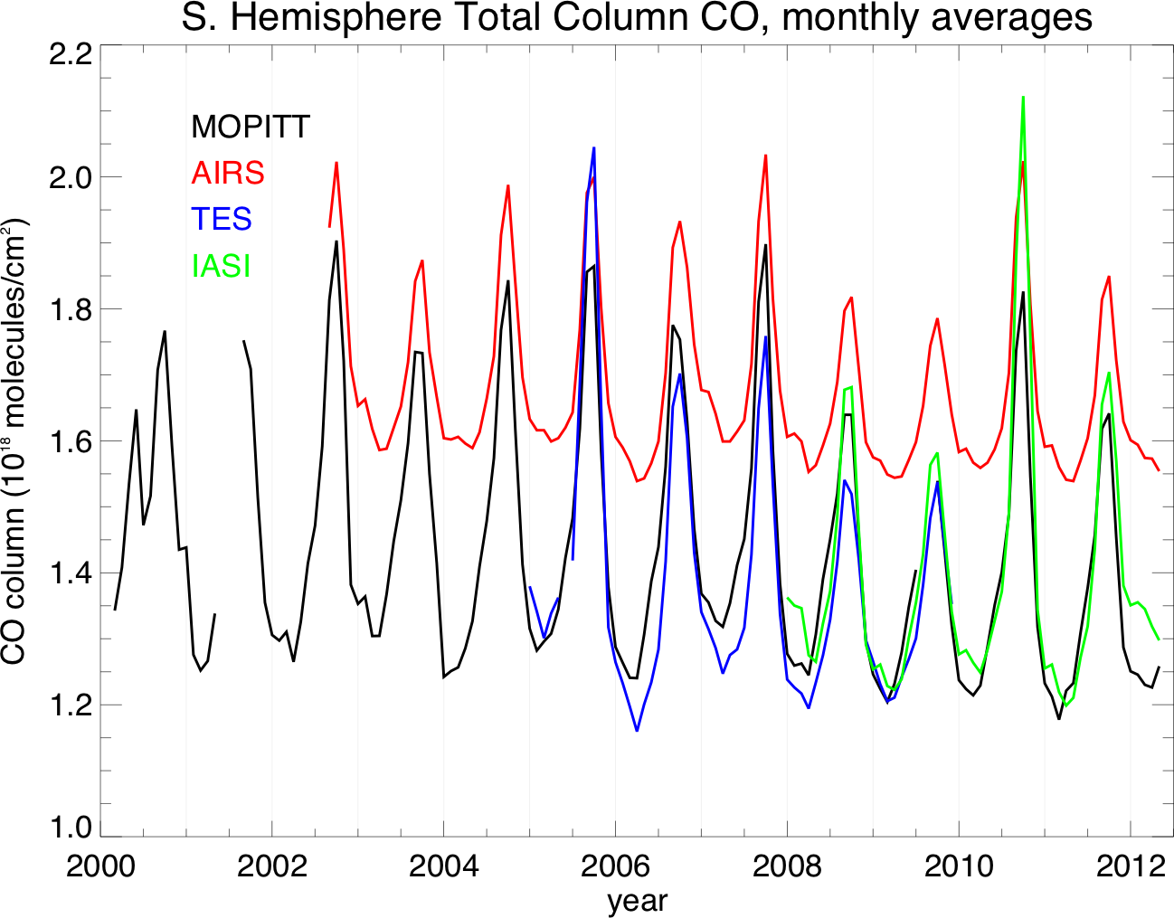
…and a seasonal cycle
0° to 60°N
0° to 60°S
AIRS bias also shown in
George et al., ACP 2009

Slide 6

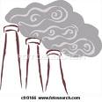


NH₃ Sources
Automobiles (catalytic converters)
Large urban centers
  50% of NH₃ in LA area
Biomass burning
Bi-directional
Flux
Industry
Fertilizer
Coal Mining
Power generation
AGRICULTURE
Animal waste (temperature dependent)
Fertilizer application

Slide 7
NH₃ in the atmosphere
NH₃ + HNO₃⬅➔NH₄NO₃
2 NH₃ + H₂SO₄➔(NH₄)₂SO₄
Long-range export
Long-range import
PM_{2.5} Particles
SO2, NOX decreasing
but NH₃ forecast to increase
Increase incidence of cardiovascular and respiratory diseases
Increase number of CCN
➔Affect cloud radiative properties
➔Climate change

Slide 8
Better emissions with TES NH₃
Largest changes western US and Mexico
Used GEOS-Chem adjoint with TES NH₃ profiles, averaging kernels and error covariances to optimize model
Optimized GC shows better agreement with AMoN network measurements
Zhu et al., 2013, JGR

Slide 9
NH₃ Algorithm structure
SIPS @SSEC
SIPS @JPL
(AER algorithms)
From each FOR (9 FOVs):
Water vapor profiles
Temperature profiles
Surface temperature
Cloud od?
Optimal estimation second step:
NH₃ profile
Error estimates
Averaging kernels
From each FOV:
Radiances
Noise
Optimal estimation first step:
Surface temperature
Emissivity
Cloud od?
Determine a priori and constraints from BT test.
First guess emissivity from University of Wisconsin database.

Slide 10
CO Algorithm structure
SIPS @SSEC
SIPS @JPL
(AER algorithms)
From each FOR (9 FOVs):
Water vapor profiles
Temperature profiles
Surface temperature
Cloud od?
Optimal estimation second step:
CO profile
Error estimates
Averaging kernels
From each FOV:
Radiances
Noise
Optimal estimation first step:
Surface temperature
Emissivity
Cloud od?
A priori and constraints from MOPITTv5 climatology
First guess emissivity from University of Wisconsin database.

Slide 11
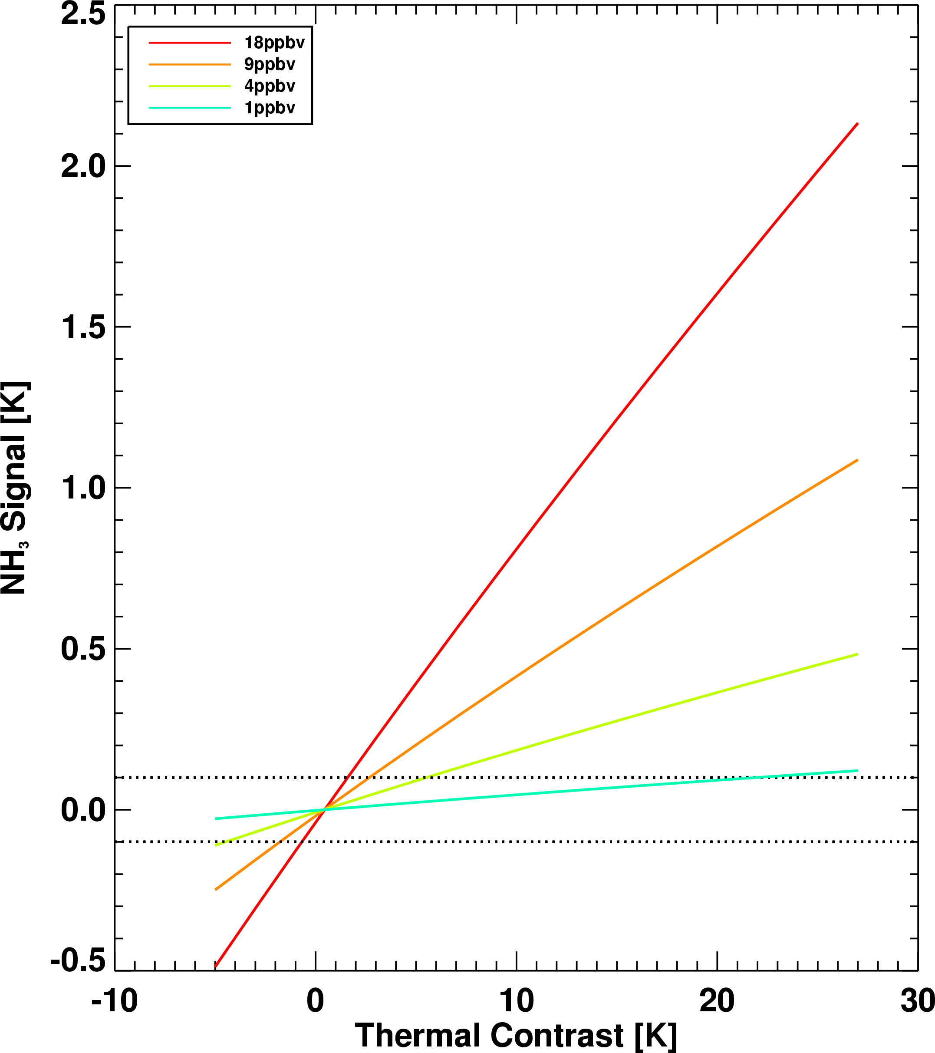
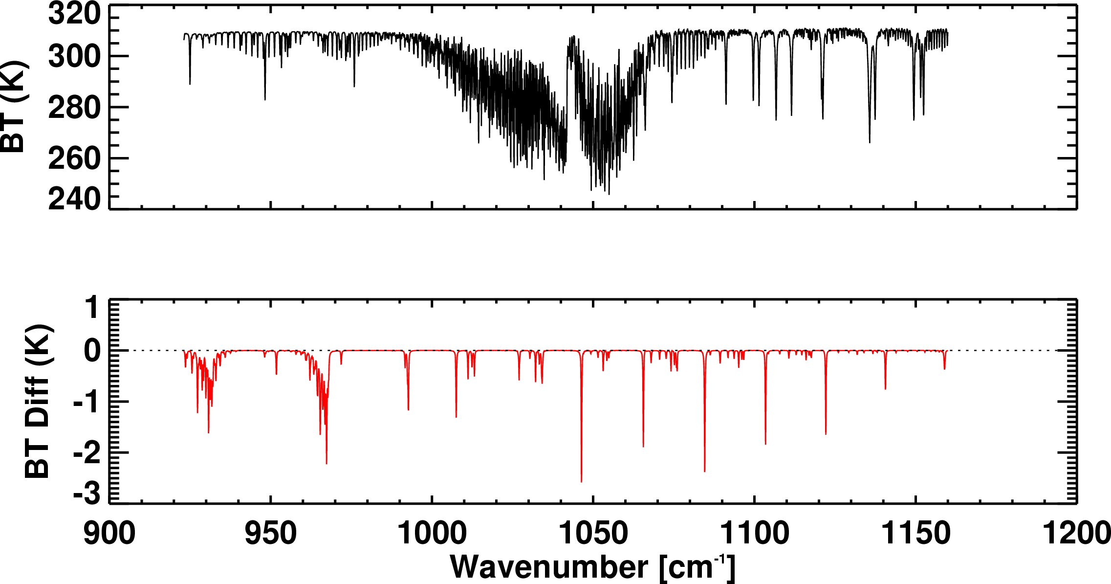
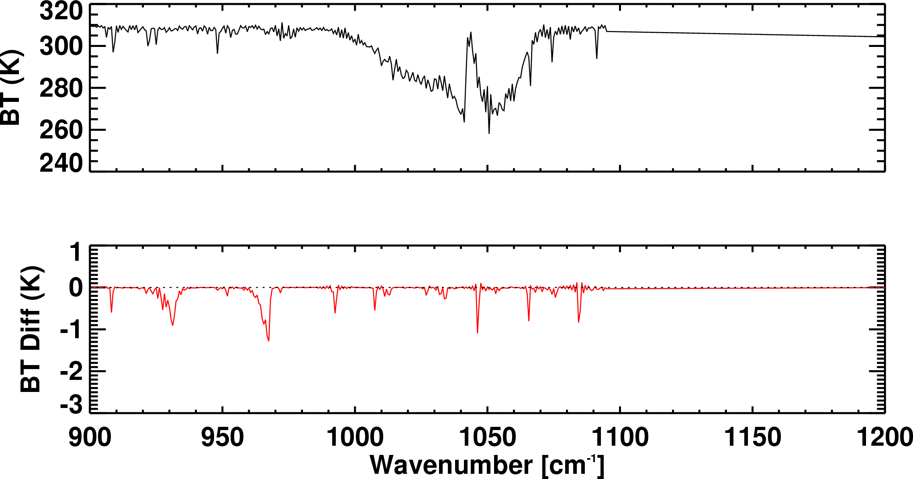
NH₃ signal from TES and CrIS
Simulated spectra and NH₃ signal
18 ppbv at surface
TES
CrIS
Detectability is ~ 1 ppbv under ideal conditions
But thermal contrast also plays a role

Slide 12
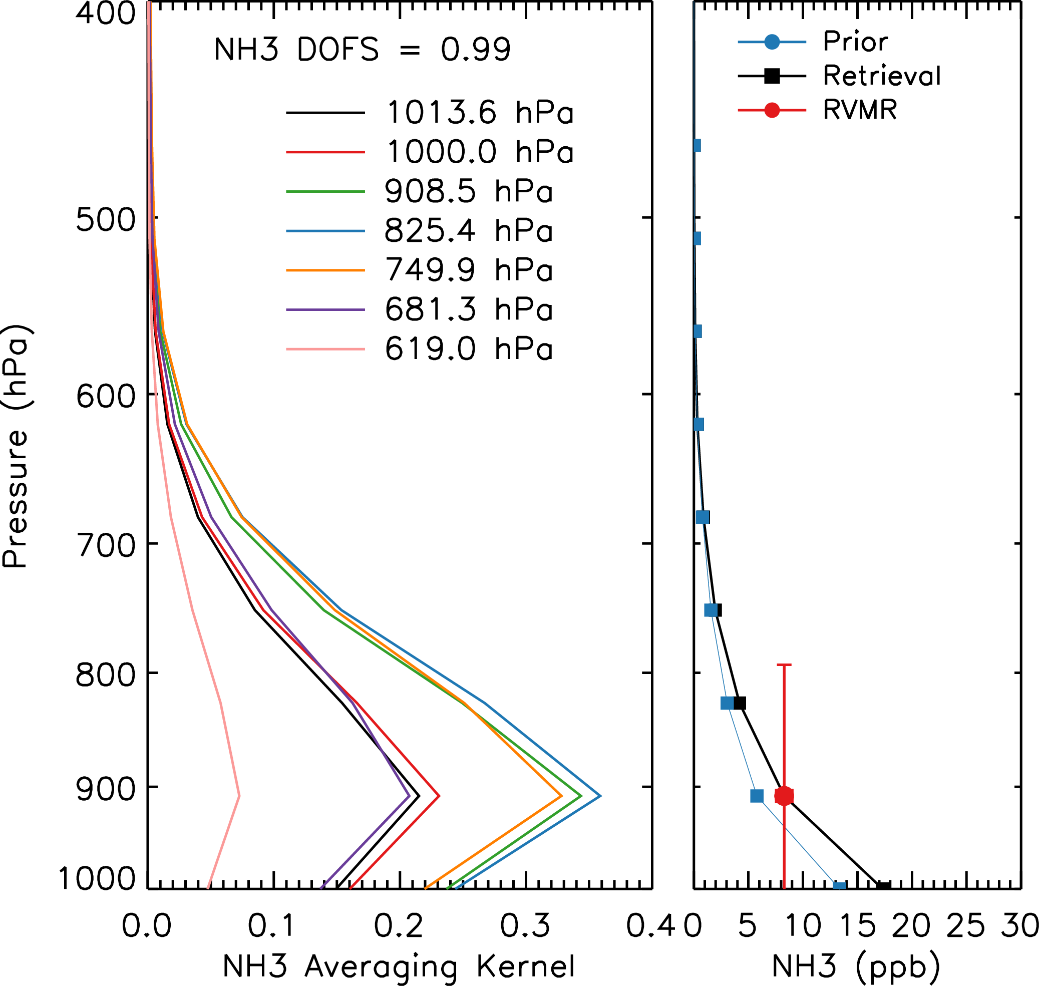
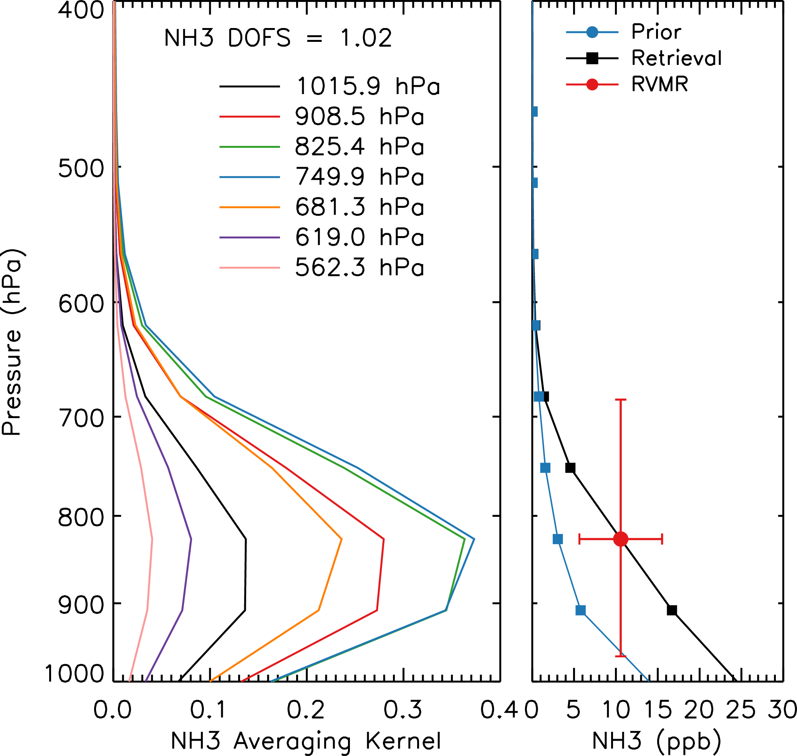
TES and CrIS Sensitivity to NH₃
TES
CrIS
Both instruments most sensitive to NH₃ between 950 and 600 mbar
TES is more sensitive to amounts lower in the atmosphere
1 piece of information or less: DOFS<1.0
Collapse all information to a single point: RVMR
  Easier to compare with in situ measurements, models and other instruments

Slide 13
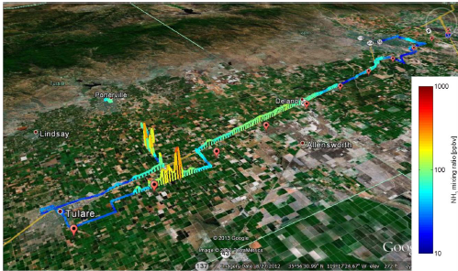
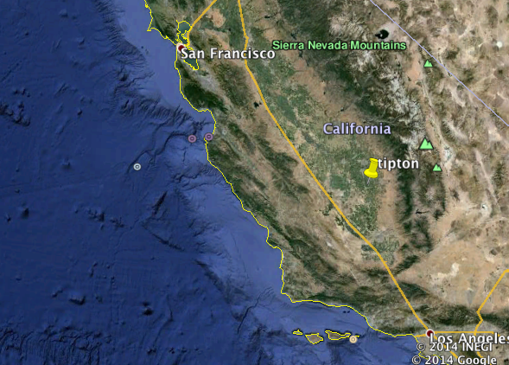
Monitoring NH₃ is difficult
NH₃ from an Open path Quantum Cascade Laser (QCL) on a moving platform in the San Joaquin Valley during DISCOVER-AQ 2013.
NH₃ is highly reactive
➔ highly variable in space and time
Miller et al., AMT, 2014

Slide 14
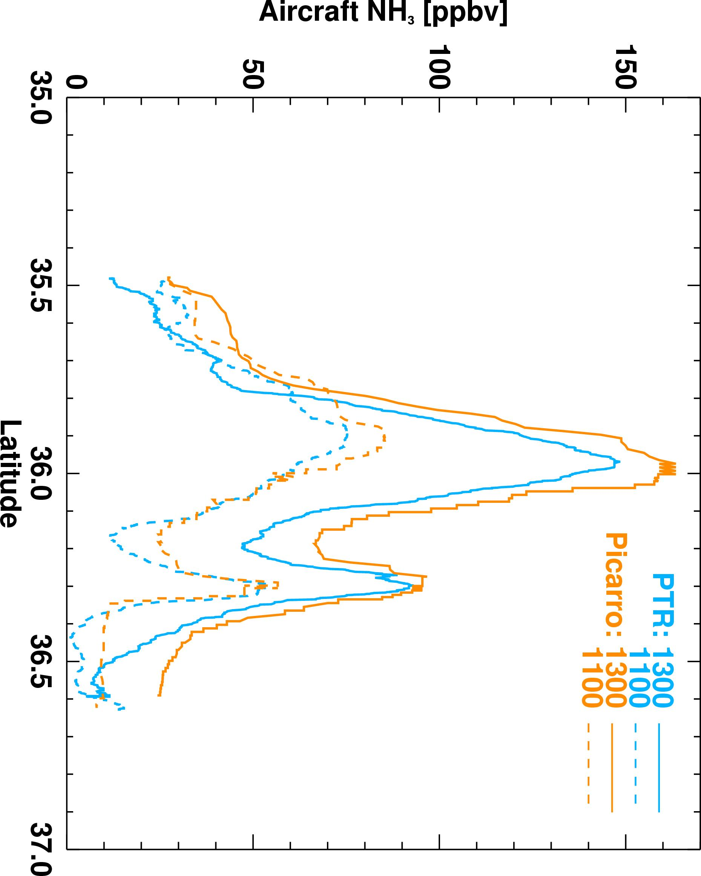
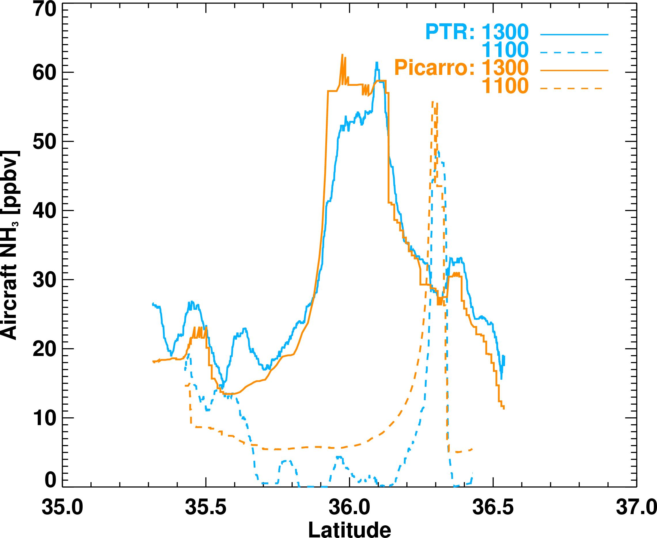
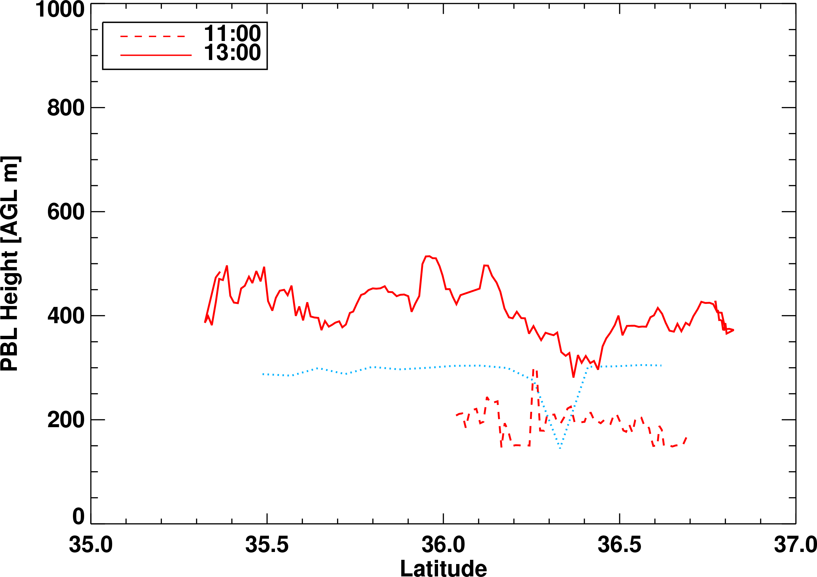
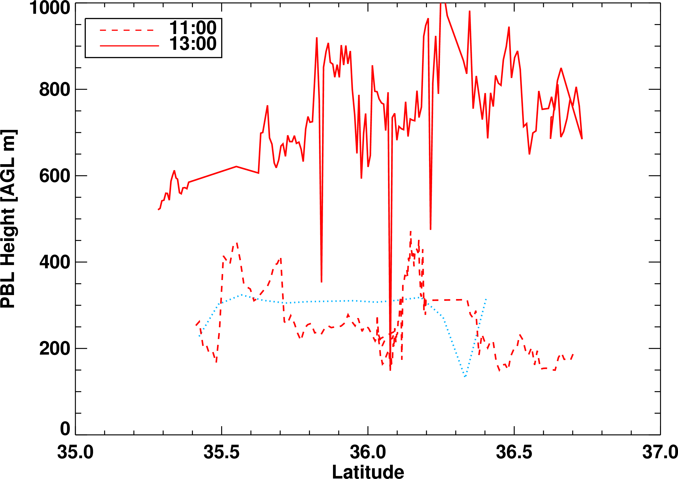

NH₃ from aircraft
DISCOVER-AQ campaign in January 2013 in the San Joaquin Valley
NH₃ from PTR and Picarro
PBL from airborne HSRL backscatter
January 21
January 30

Slide 15
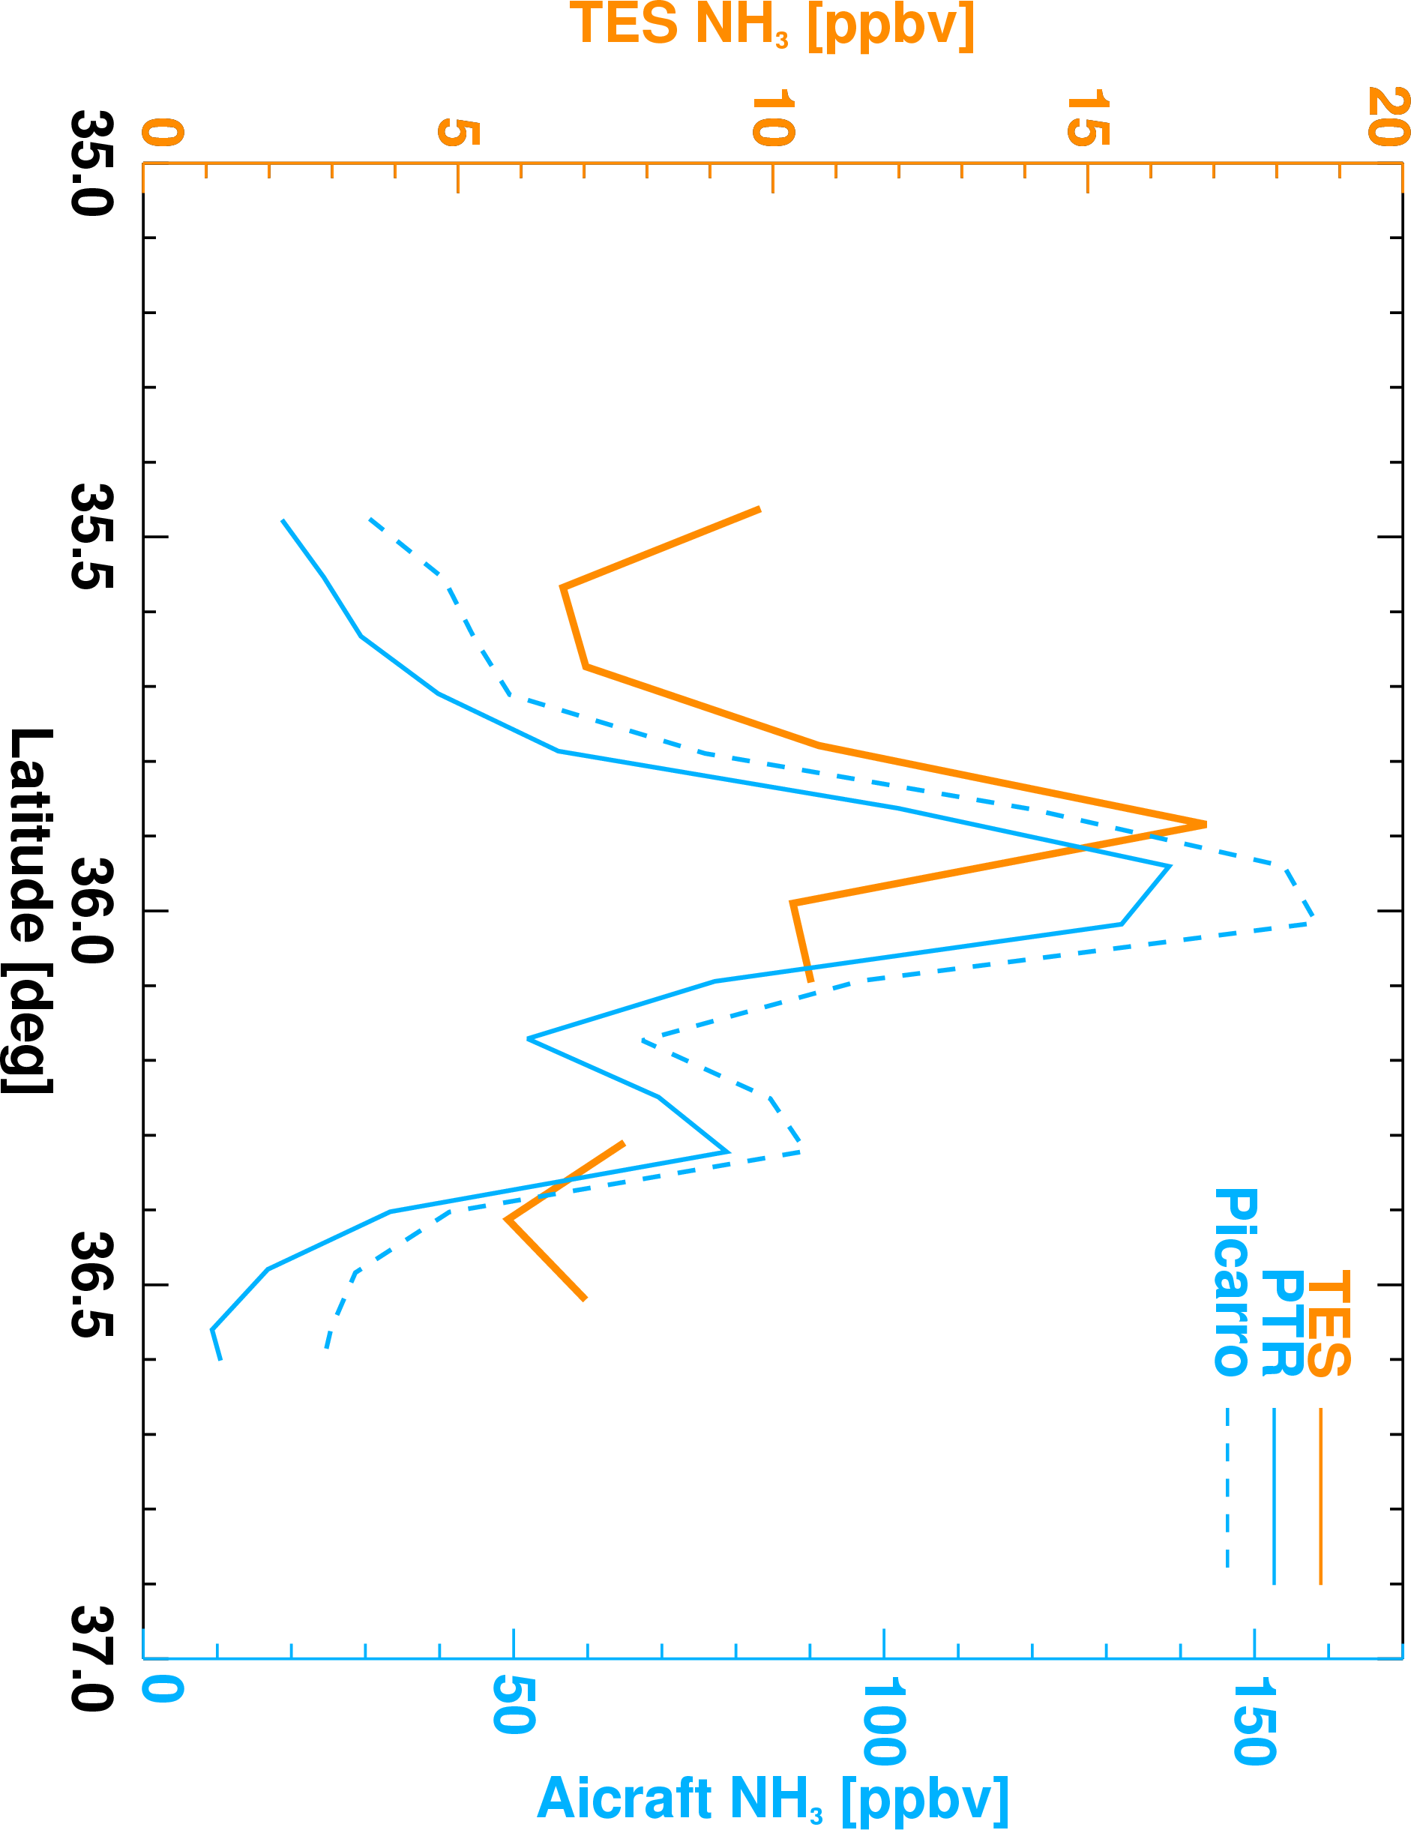
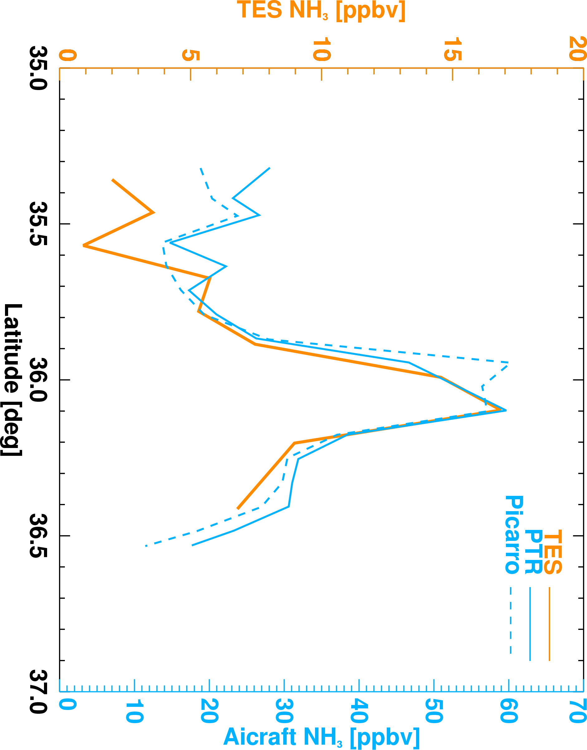
How TES compares
January 21
January 30
RVMR
P3B aircraft @ 300 m: point measurement
TES maximum sensitivity between 1 and 2 km
  5x8 km footprint
TES and aircraft NH₃ are well correlated

Slide 16
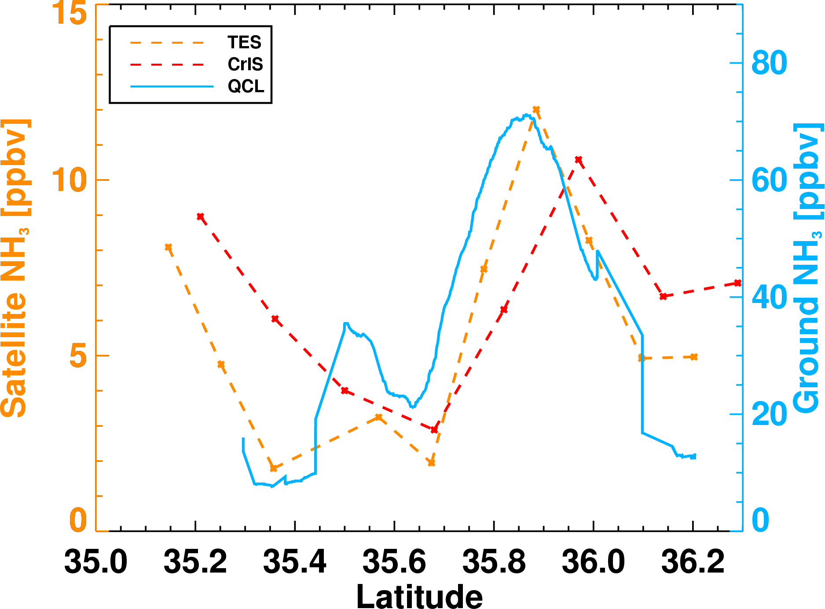
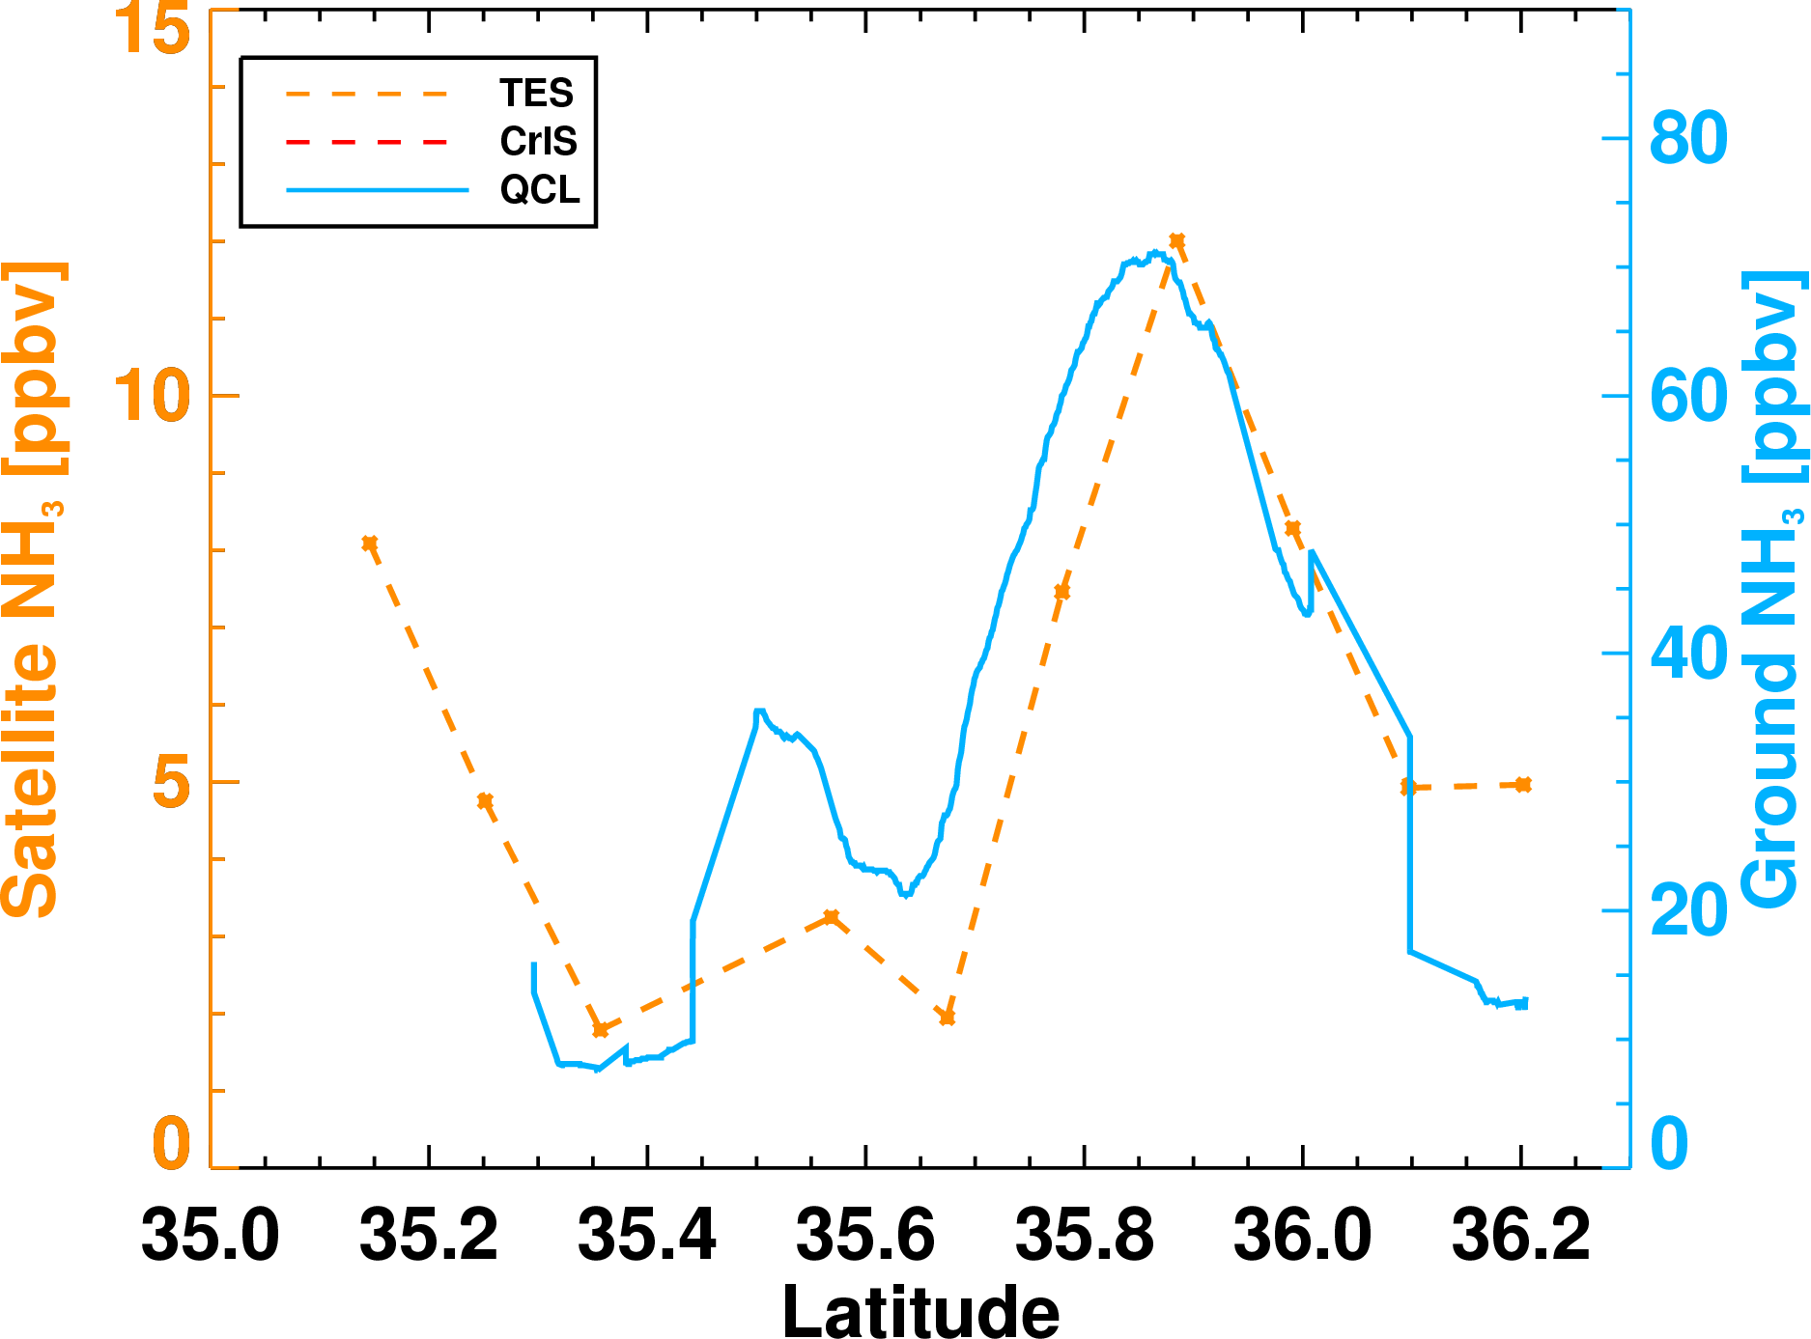
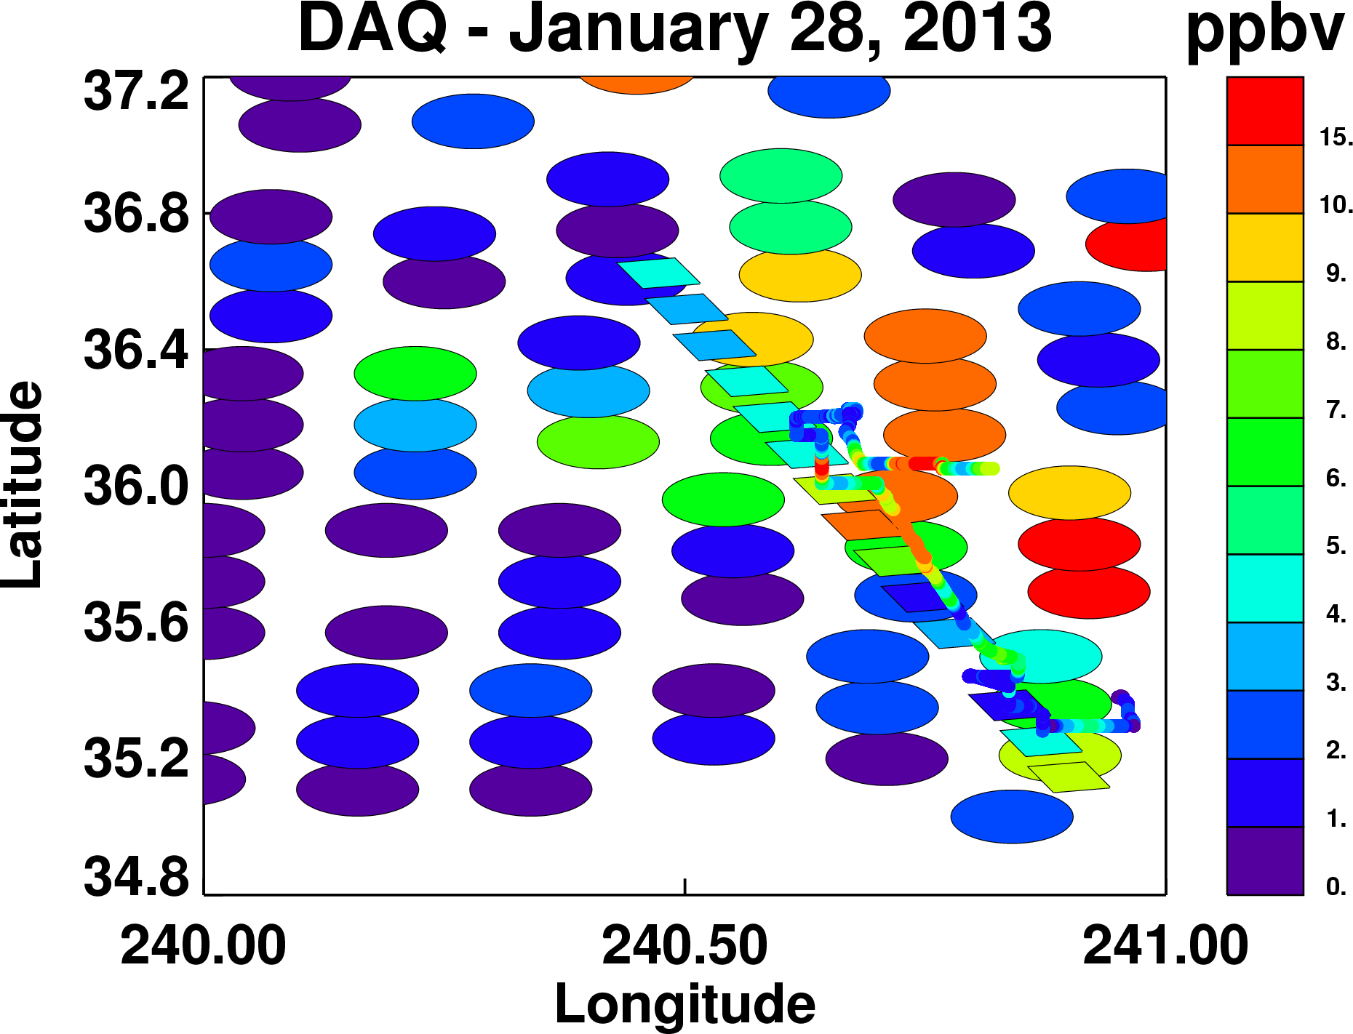
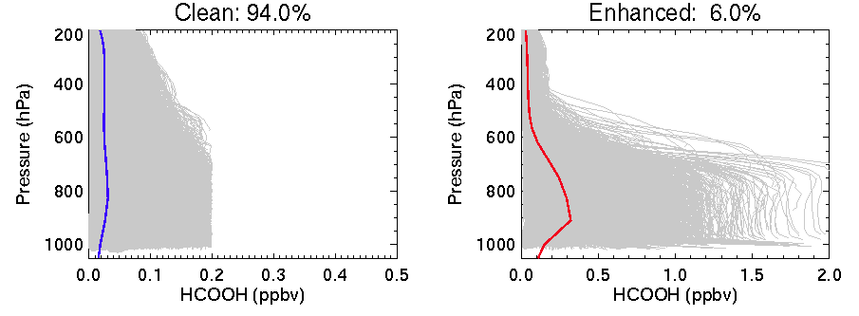
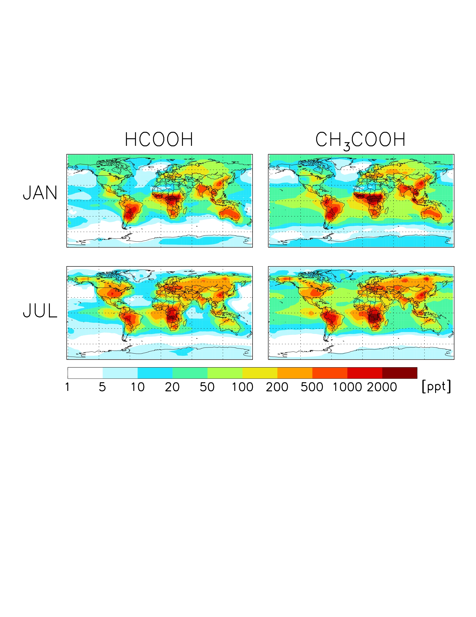
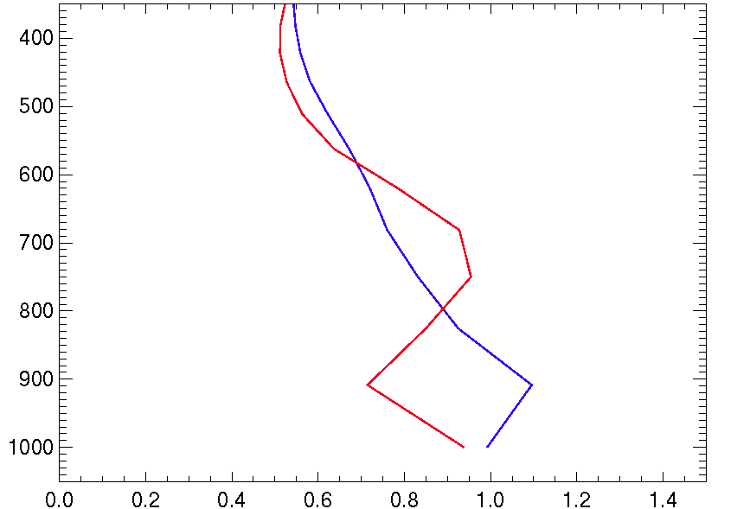
Satellite and surface NH₃
QCL directly under TES transect in the San Joaquin Valley on January 28, 2013

Slide 17
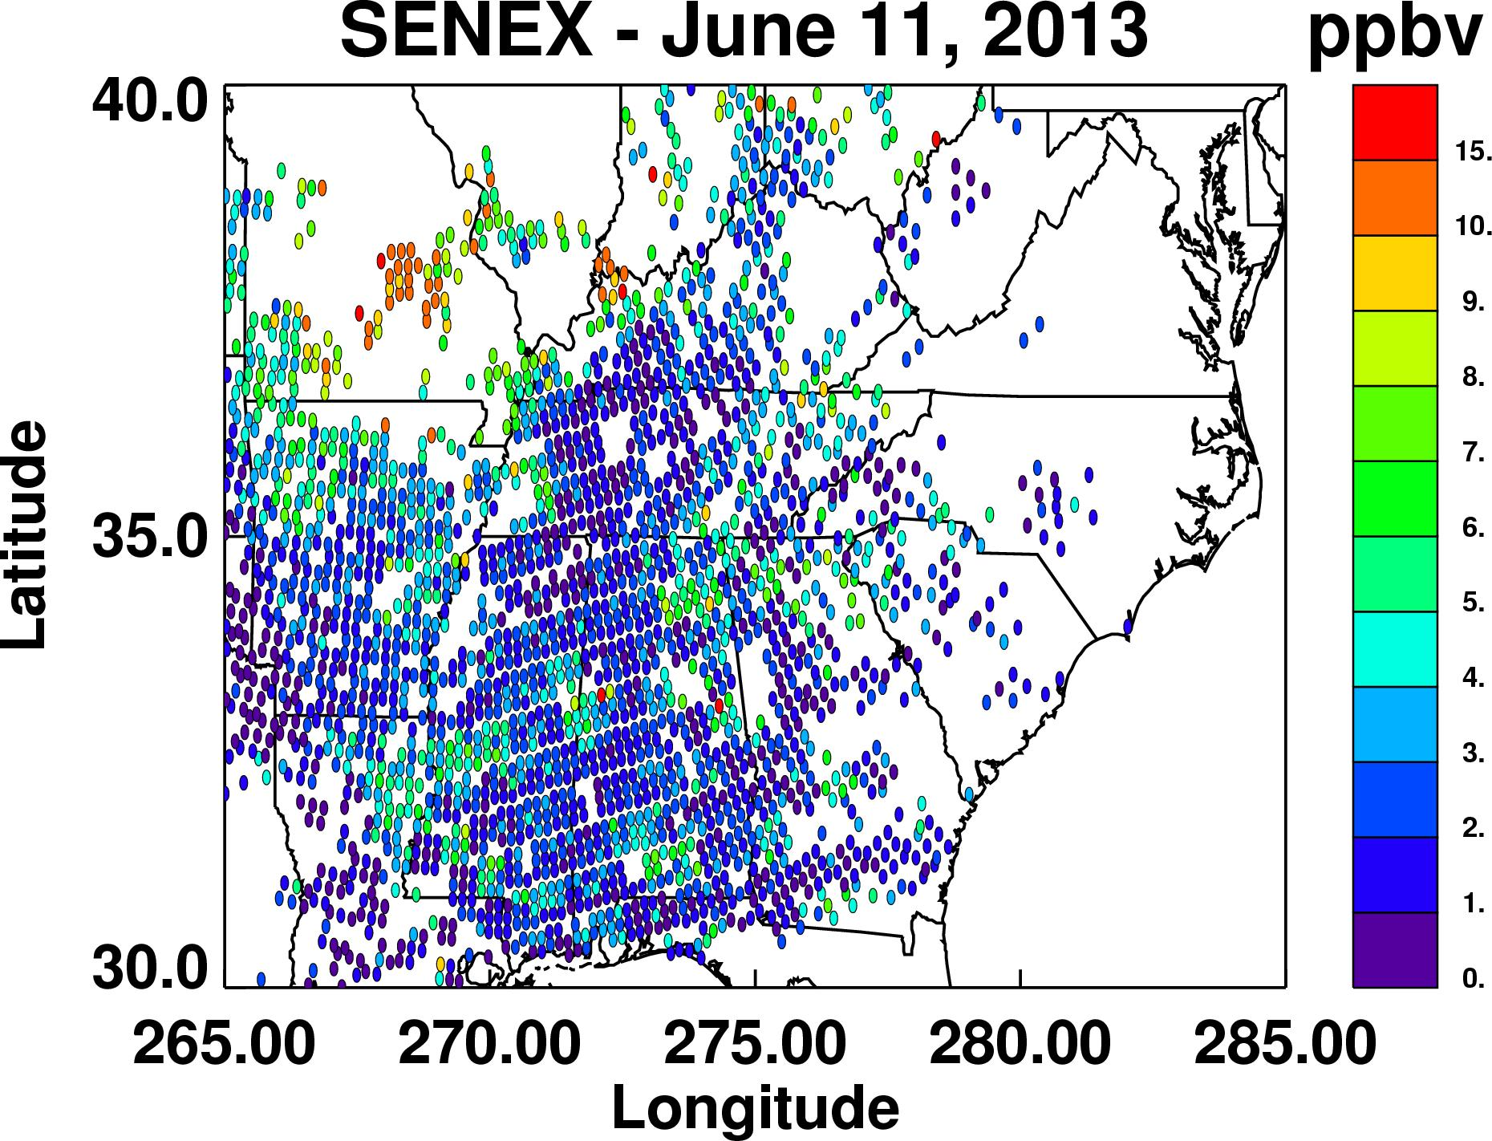
CrIS NH₃ – June 11, 2013
SENEX area

Slide 18
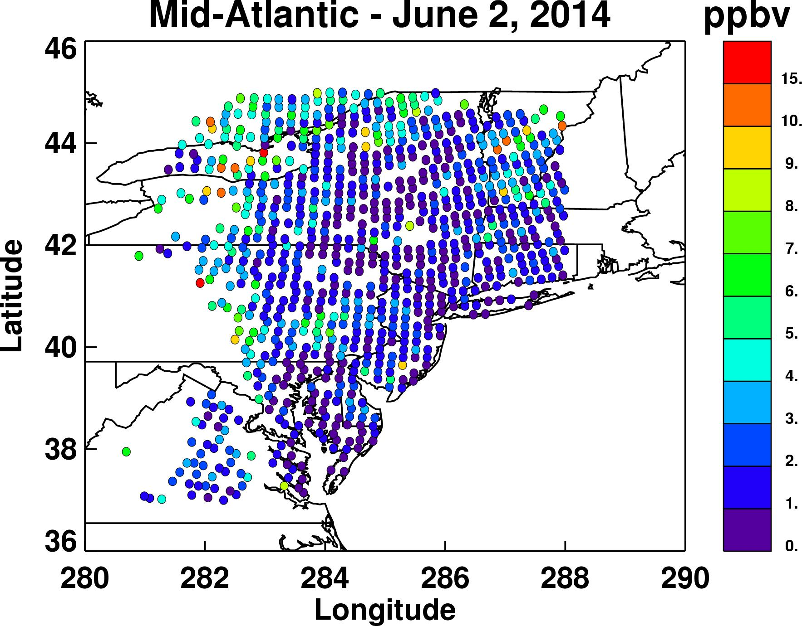
CrIS NH₃ – June 2, 2014
Mid-Atlantic states

Slide 19
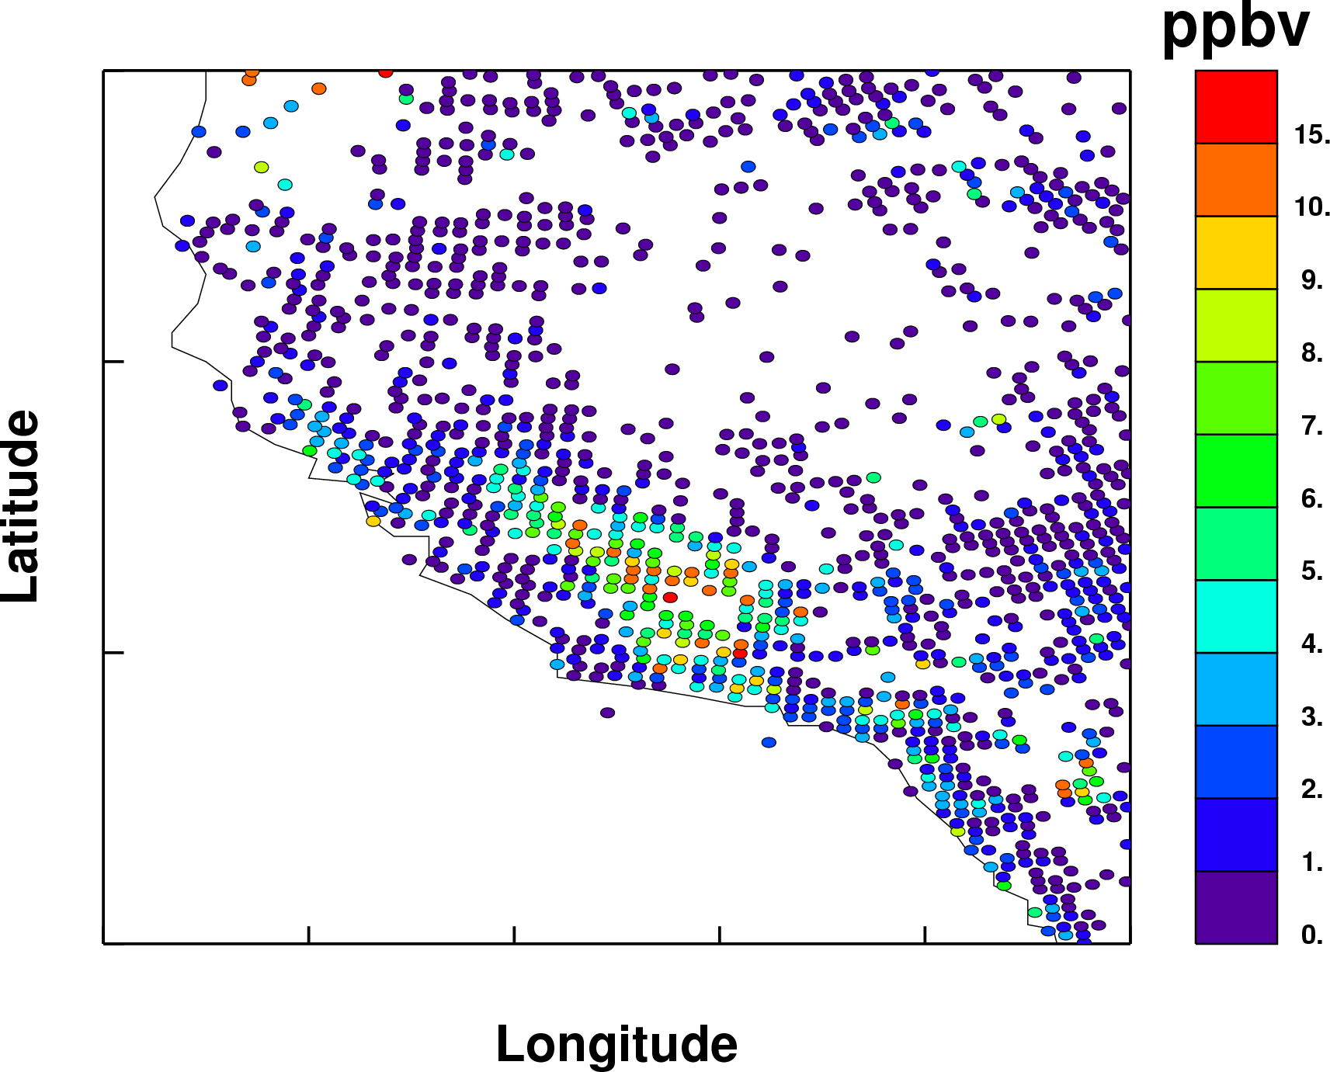
Where is this?

Slide 20
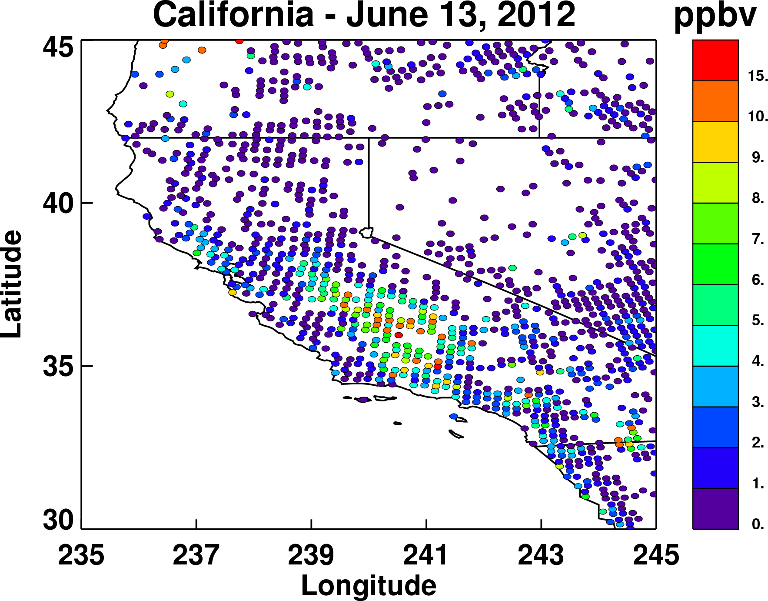
CrIS NH₃ – June 13, 2012
CrIS
CARB emissions

Slide 21
Final comments
CO from CrIS
  Will provide continuity to database established by AIRS, MOPITT and TES
  High resolution CrIS data is essential for accurate retrieval
  Algorithm to be delivered to the Sounder SIPS by the end of 2016
NH₃ from CrIS
  Leverages experience with TES NH3
  Sensitive to only higher amounts (> 1.0 ppbv) of NH₃
  Requires some thermal contrast to detect NH₃
  Captures spatial variability as measured by a surface instrument
  Provides greater temporal and spatial coverage than aircraft campaigns or surface networks or even TES
  Algorithm to be delivered to the Sounder SIPS by the end of 2015

Slide 22
Acknowledgements
  Markus Mueller and Tomas Mikoviny from the PTR instrument team
  PICARRO instrument team
  TES team at JPL
  Jesse Bash and Rober Pinder from the EPA
  Research was supported by
    the Jet Propulsion Laboratory, California Institute of Technology under contract to the National Aeronautics and Space Administration (NASA).
    NOAA Climate Program Office (CPO) Grant number NA130AR4310060
    CU support from NASA grant NNX10AG63G and EPA-STAR RD83455901
    Princeton support from NASA grant NNX12AN64H

Slide 23
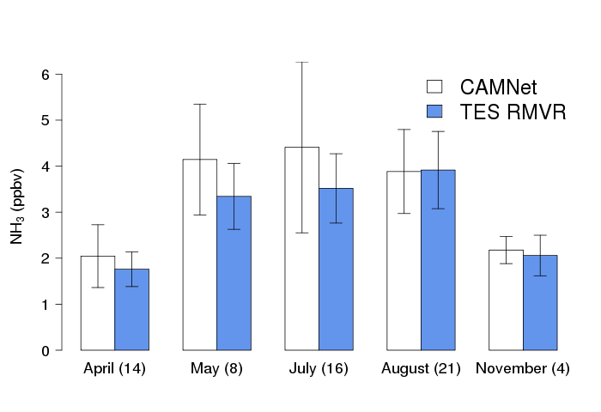
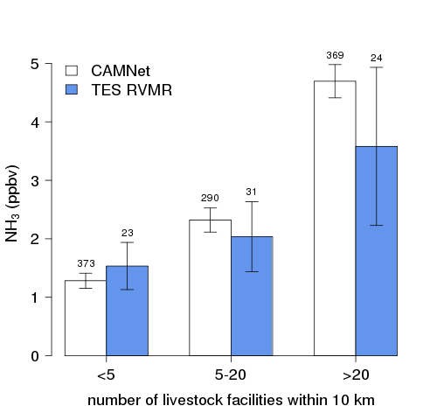
In situ and TES in North Carolina
NH₃ vs time
NH₃ vs source concentration
TES and surface measurements are qualitatively well correlated
Pinder et al., GRL, 2011

Slide 24
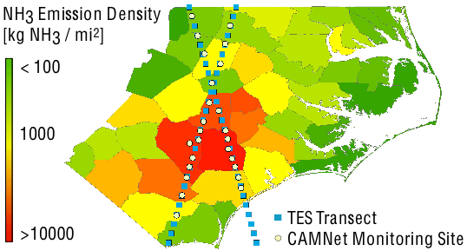
Validation in North Carolina
North Carolina
Intense livestock farming (hogs, chickens, turkeys)
EPA CAMNet NH₃ monitoring network
TES high spatial density observations (transects)
Feb – Dec 2009
Allows detection of spatial variability and seasonal trends
CHALLENGE
  TES: instantaneous profile over 5x8 km
  CAMNet: two week average at a surface point
  Cloudy summers!

Slide 25
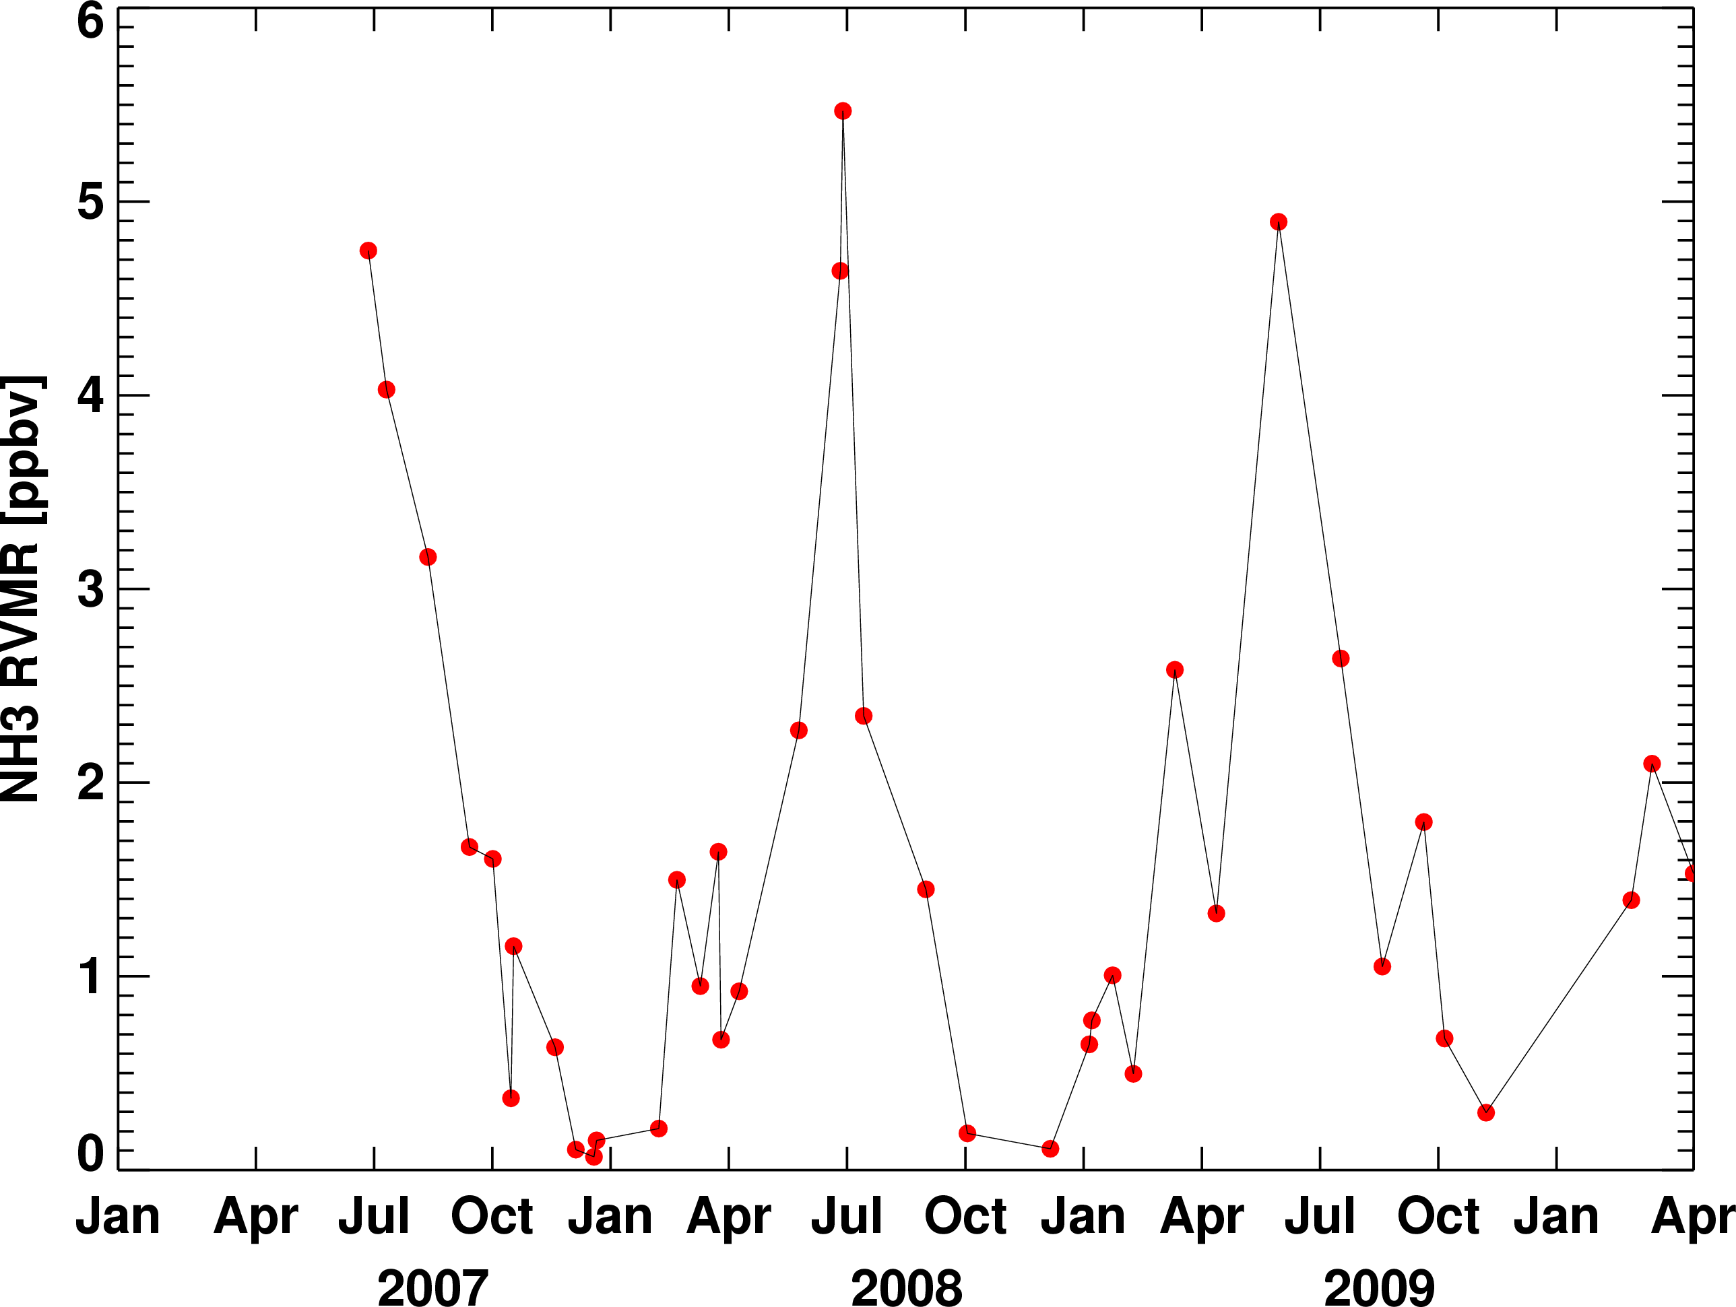
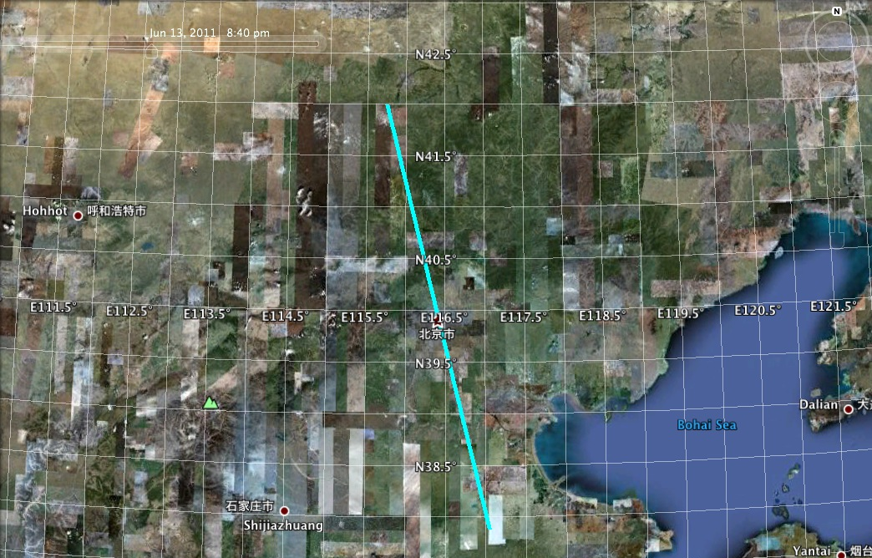
Eastern China: 2007-2009
TES transect path
TES NH₃ over Beijing
Shangdianzi
Beijing
Beijing
Shangdianzi
Surface NH₃
Meng et al., ACP, 2011

Slide 26
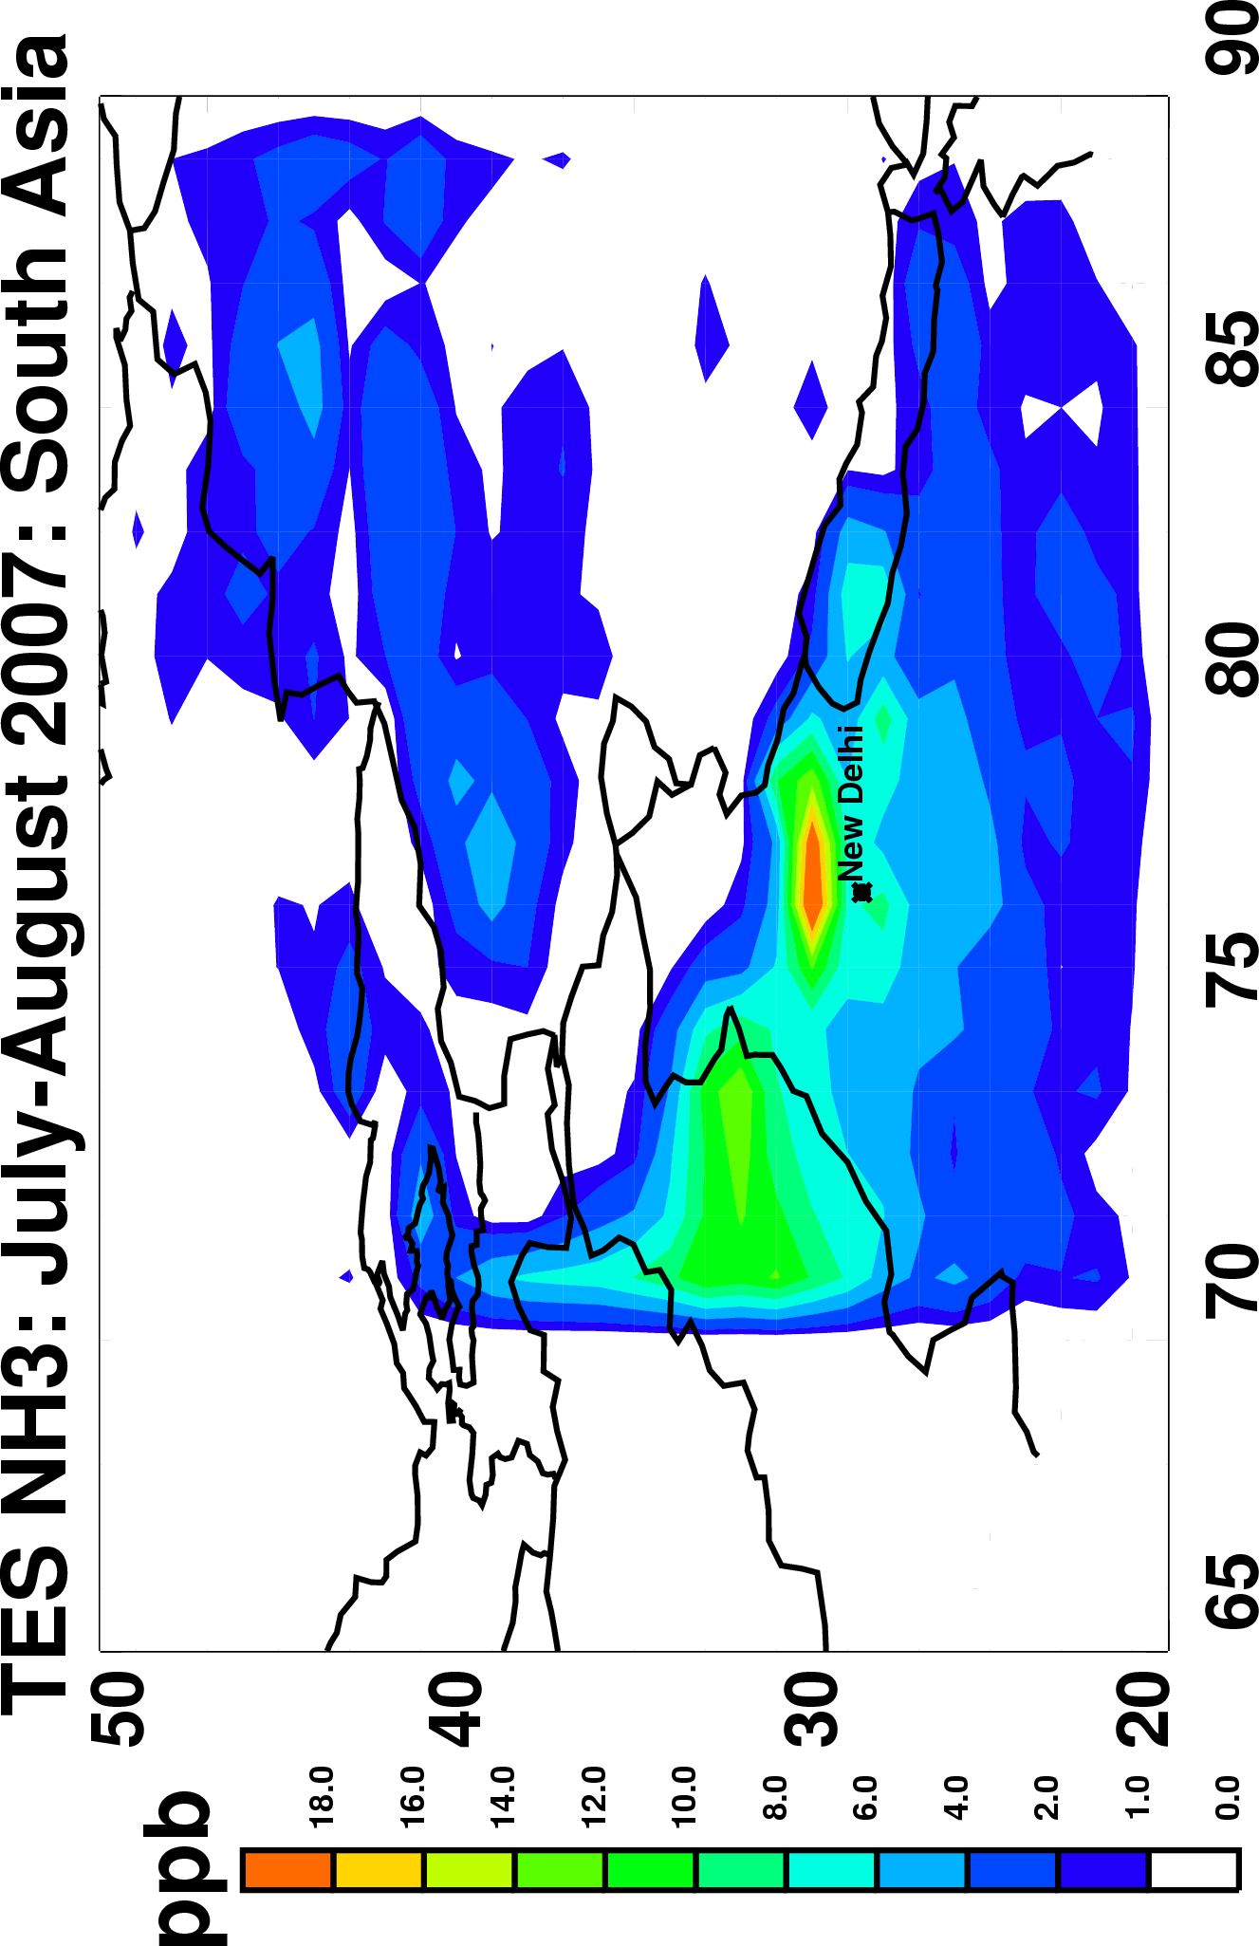
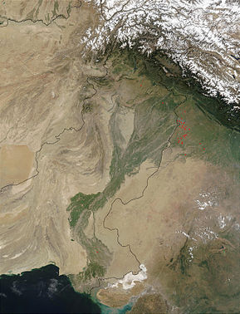
South Asia: July-August 2007
Indus River Valley
High NH₃ north of New Delhi and in the northern Indus valley

Slide 27
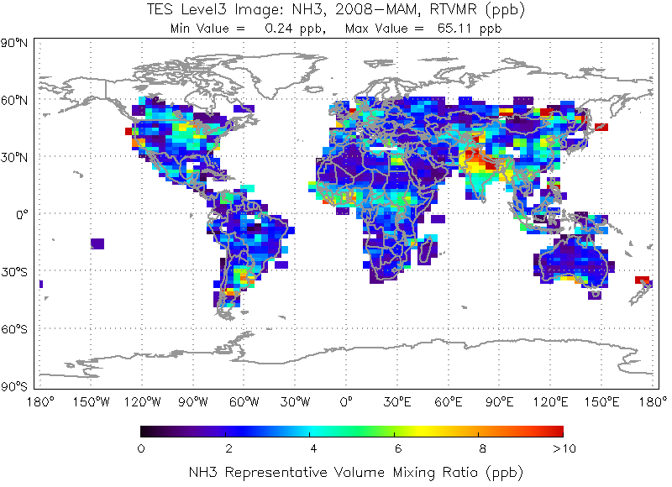
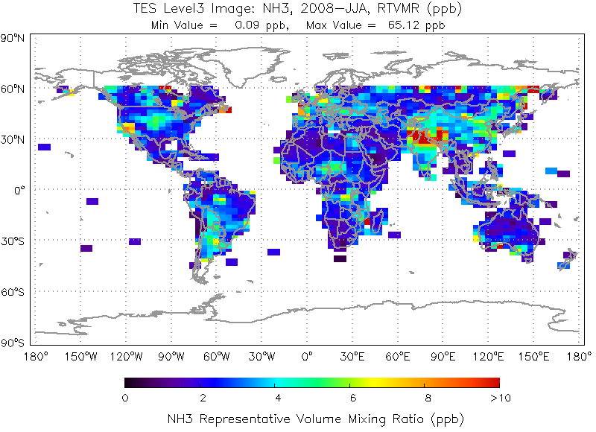
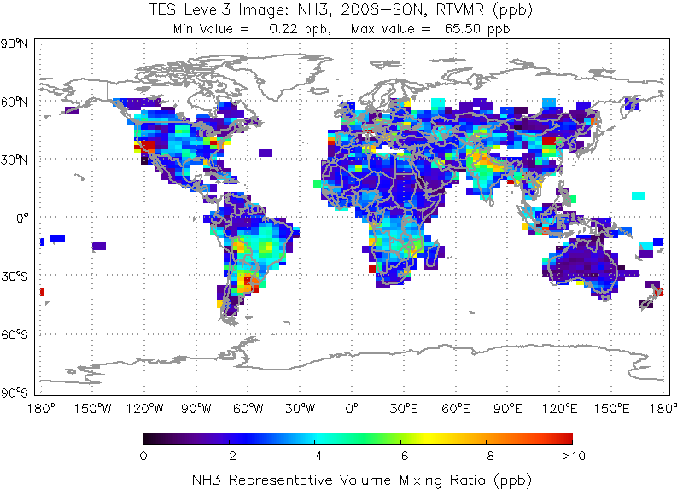
Global NH₃ results
Seasonal TES NH₃ means from 2009 Global Surveys
High NH₃ in North American growing season
Hotspot over India and elevated amounts over eastern China
Biomass burning signal over South America and Africa

Slide 28
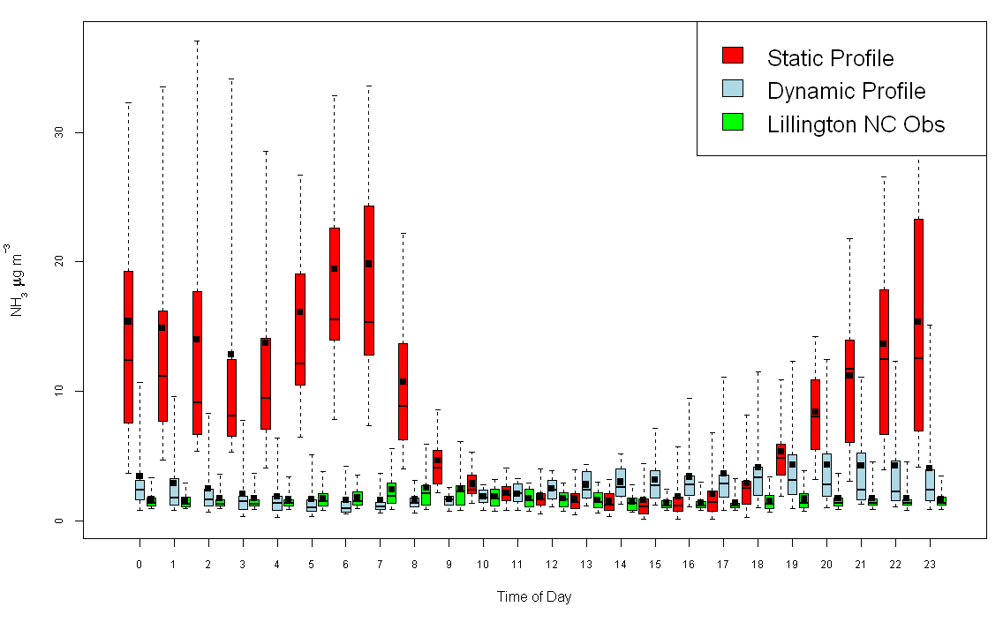
Measuring NH₃ daily variations
North Carolina in situ data
CMAQ model with different temporal emission profiles
  Static profile
  Dynamic profile

Slide 29
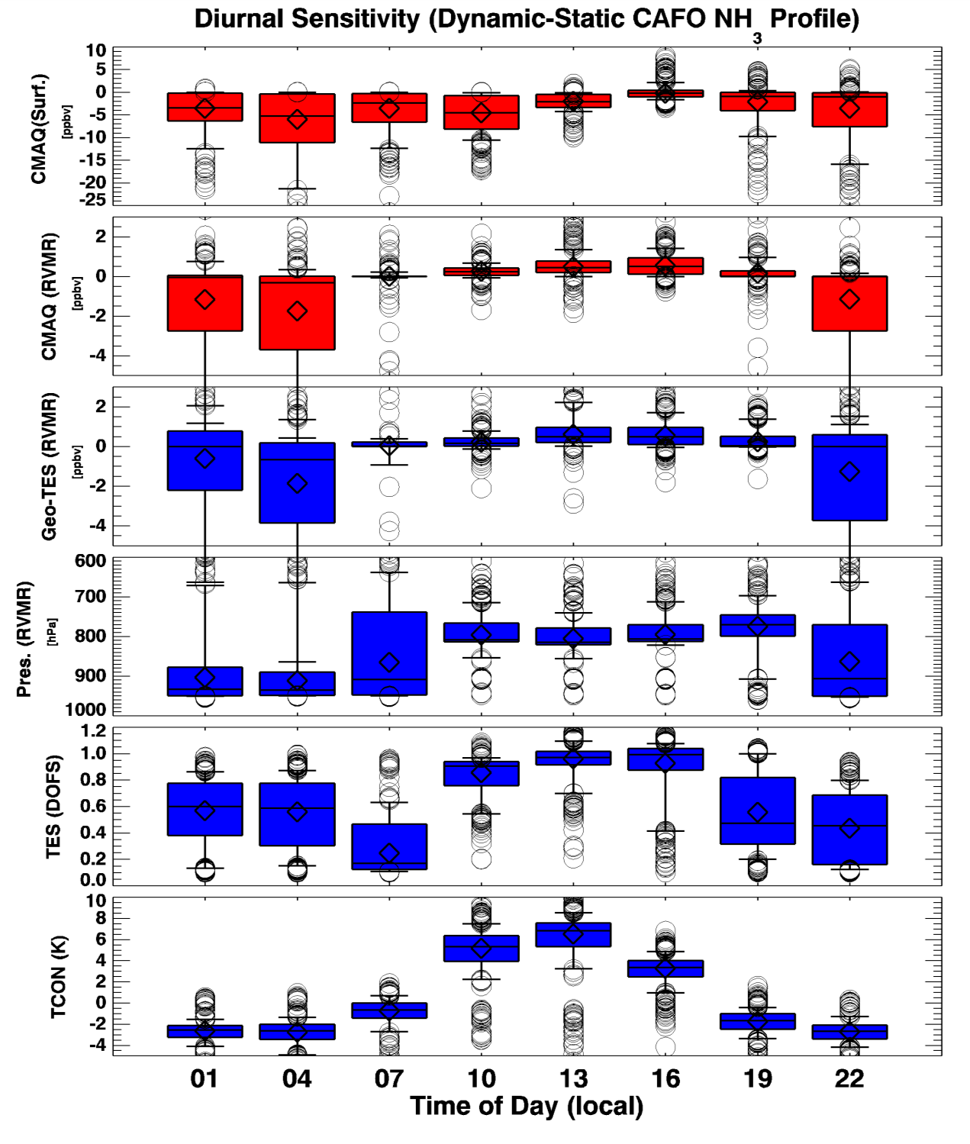
NH₃ from a geostationary platform
CMAQ vs Simulated Retrievals
TES-like instument
Geostationary platform
Provides data every three hours
CMAQ profiles over California for a warm July day
Difference in CMAQ NH₃ matches difference in retrieved NH₃

Slide 30
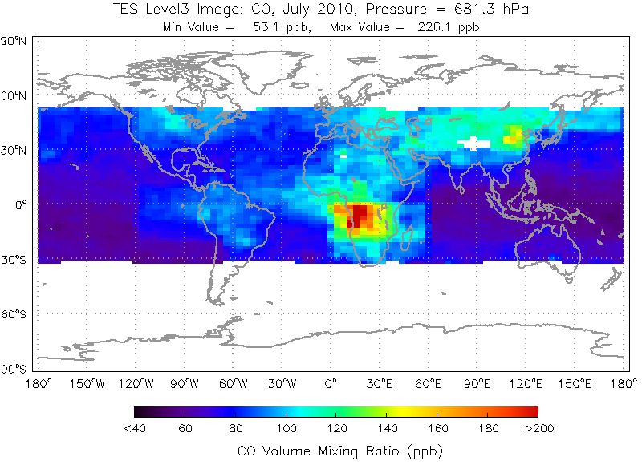
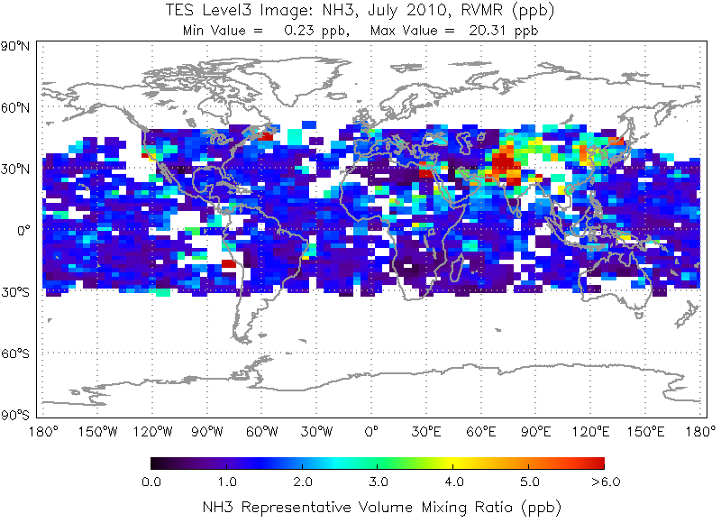
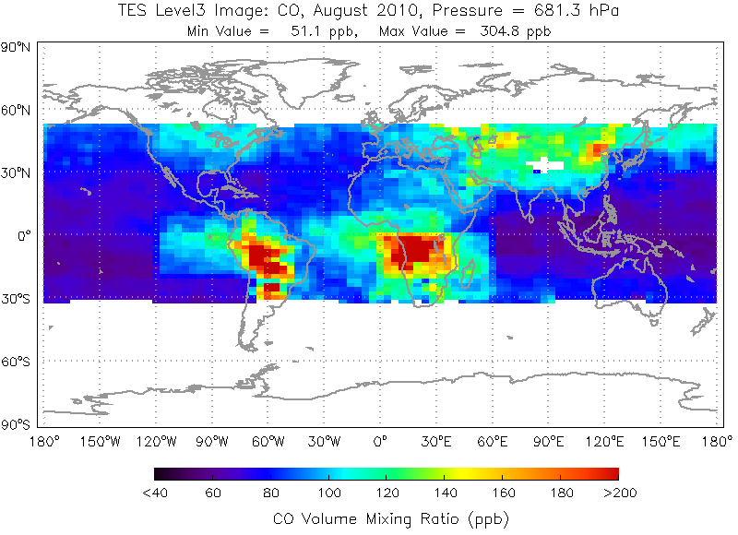
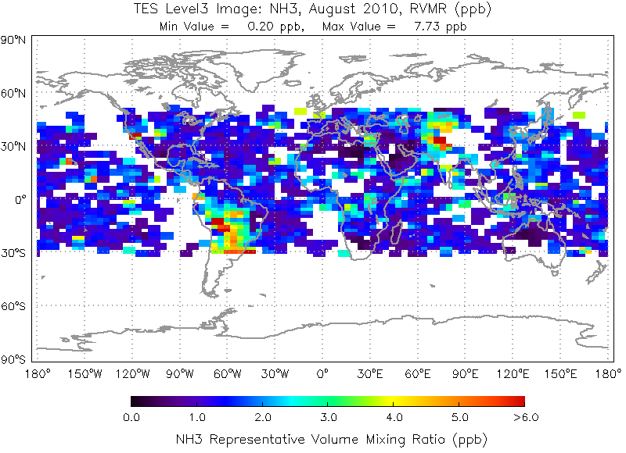
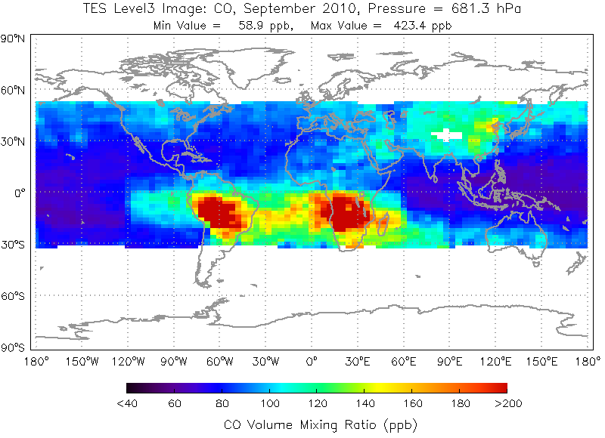
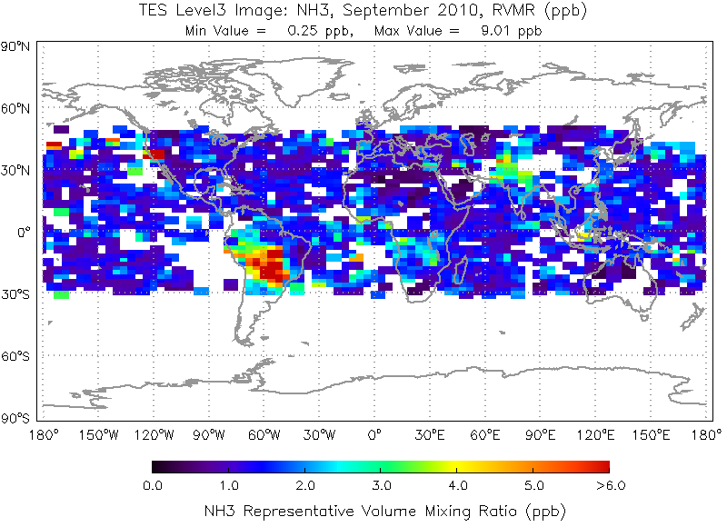
TES NH₃ and CO
Monthly CO at 681 hPa
Monthly NH₃ RVMR
NH₃ from TES V005 operational product
July 2010
High NH3 values over northern India
Aug 2010
Biomass burning in South America is evident in both CO and NH₃ maps
Sept 2010

Slide 31
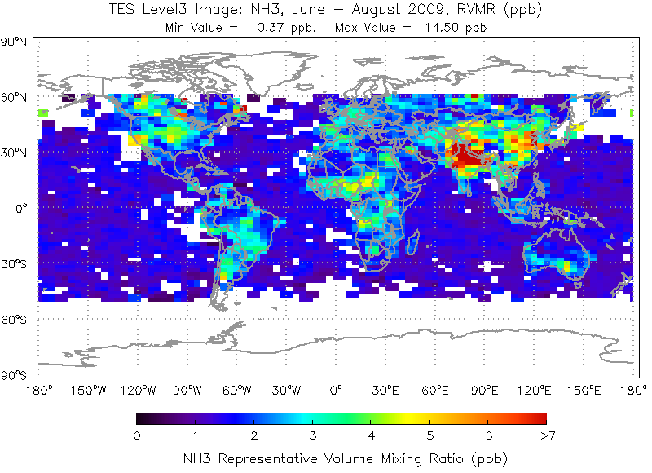
And now …
NH₃
Shephard et al.[2011]

